Slide 1



What’s Driving the Immune Health Shift
A New Era of Immune Defense
Notes:
Hi my name is Geoff Melcher with REV222 and we are in a new era of immune defense. We are going to talk about What is driving the immune health shift.

Slide 2

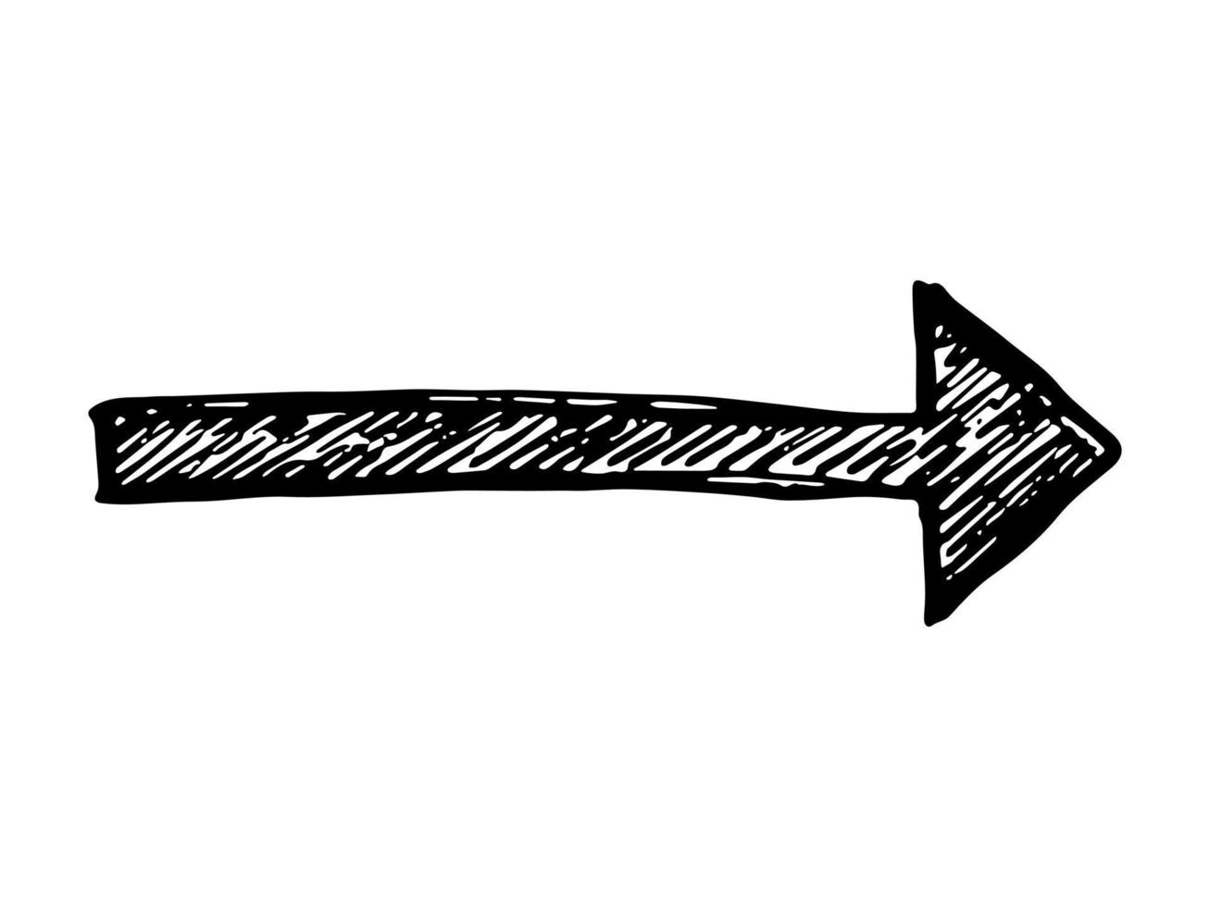
Download slides and watch presentation!
REV22-2.com/presentation/
Notes:
If you are watching this great! You can still scan this QR code to download the presentation and slides. If you are watching this on your phone, take a screen shot. The QR code takes you to rev22-2.com forward slash presentation. If you don’t have an account yet, or can't remember your password, at the end of the presentation I will have a QR code that will bypass the account login and let you place an order. Remember, REV222 products are only available to you and not the public. Lets get started.

Slide 3
Thank You!
“PEOPLE” are looking for “OTHER” people to have all the answers.
When you share information on something you are now giving a review.
You are now … THE EXPERT
You are now … THE PHYSICIAN
You are now … THE SPECIALIST
You are now … THE HEALER
You are now … THE MD
You are now … THE GENERAL
PRATITIONER
Notes:
Thank you… Thank you for taking the time to educate yourself. NEXT “People” are looking for “other” people to have the answers. When you share information with someone you now become the Expert, Physician, Specialist, Healer MD, GP. That is why people love reviews! For you specifically, when you speak to colleges, they see you as the expert of specialist. Lets make you an expert.

Slide 4
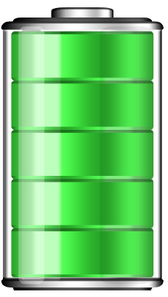

Information = Power
That is why are started my career in science and research.
REV222 is a company centered around research and information.
How did we deal with illness pre-2020? What did we learn from Covid-19? How did humans deal with illness in ancient times?
Your immune system is the key to all illnesses.
Notes:
Information is power. That is why I started my career in research. REV222 is centered around research and information. NEXT Your immune system is the key to any illness. NEXT How did we deal with illness pre 2020? What did you learn from Covid? How did humans deal with illness thousands of years ago?

Slide 5
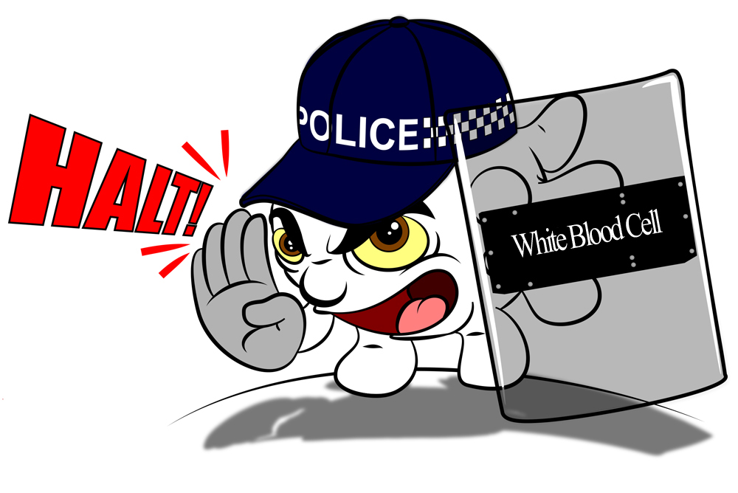
Immune System
Macro: Big Picture
Micro: Small Picture
Notes:
Your immune system is at the center of every answer. I view the immune system as 2 main components. Macro or big picture and Micro or small

Slide 6
Immune System Big Picture
Prioritize Sleep – consistent sleep produces more cytokines proteins that target infection and inflammation. Thereby enhancing your ability to fight off viruses and recover faster.
Exercise Routine – regular exercise helps circulate white blood cells and lowers stress hormones, making it easier for your immune system to detect and respond to pathogens early.
Immune-Friendly Diet – a nutrient-dense diet provides essential vitamins and minerals that strengthen the function of immune cells and reduce inflammation throughout the body.
Fresh Air & Sunshine – sun exposure increases natural vitamin D production, supporting the production of anti-microbial peptides that help kill invading bacteria and viruses.
Notes:
Here are some lifestyle changes and the effect on the immune system. We know that sleep helps your body produce proteins that target infections and inflammation.
Regular Exercise increases circulation and lowers stress hormones making your immune system more responsive.
A proper diet is required for normal body function specifically vitamins and minerals. Like Vitamin D with fresh air and sunshine.

Slide 7
Immune System Big Picture
Reduce Chronic Stress – managing stress helps lower cortisol levels, which suppress the immune system.
Hydration – keeps your mucous membranes moist and functional, trapping germs before they enter your body, and supporting lymphatic drainage.
Gut Flora – Maintaining a healthy gut flora, your overall immune system shows improvement in communication between gut bacteria and immune cells. Up to 70% of your immune cells reside in the gut.
Notes:
Reducing stress and cortisol levels which suppress the immune system is another way to help the big picture immune system.
Good water not only helps your body flush toxins but also lymphatic draining.
Lastly your gut, where there are more Nero-transmitters in your gut than your brain.
We are in a new era of immune support.

Slide 8
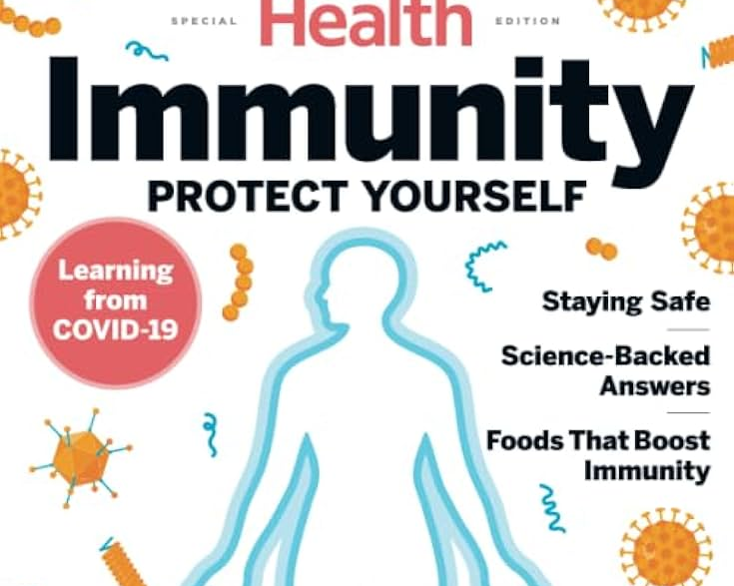
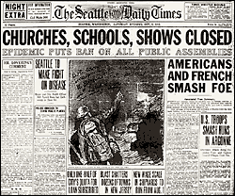
Boost your immune system with _______ OR The immune support kit starts with _______ Supercharge your immune system with _______ OR I’m less sick with _______
OR Want a healthy immune system? Start with _______
Notes:
Look at the newspaper. Look familiar? “Churches Schools Shows Closed” This wasn’t for 2020… this is from 1918 and the Spanish flu epidemic. What came from this event was the flu vaccine. It took them 40 years but the Spanish flu was the driving force for the flu vaccine. Since Covid in 2020, the new push is immune system support. The real solution for Covid was a strong immune system or a product that boosted your immune system. NOW… Everywhere you look there seems to be a new advertisement or product that will BOOST your immune system. I see taglines like: Boost your immune system with _______ ; Supercharge your immune system with _______ ; I’m less sick with _______.

Slide 9
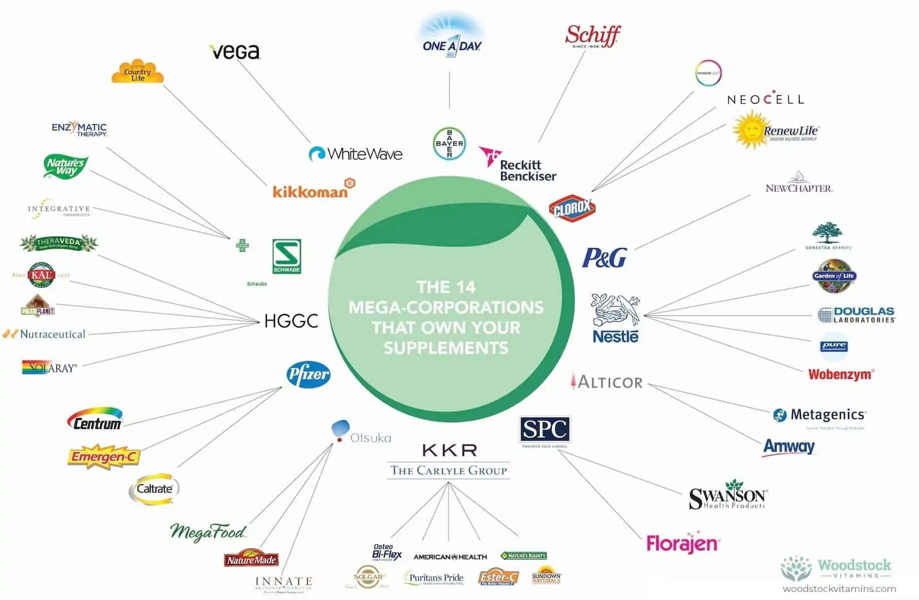
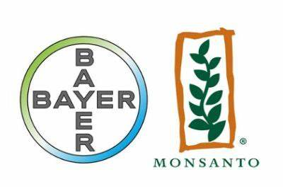
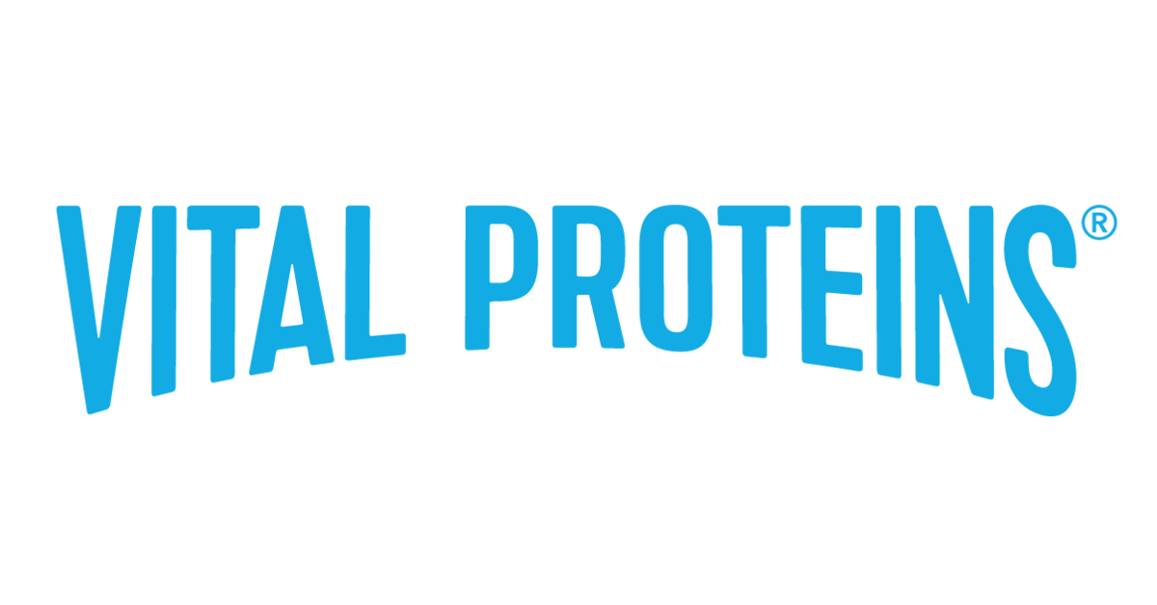
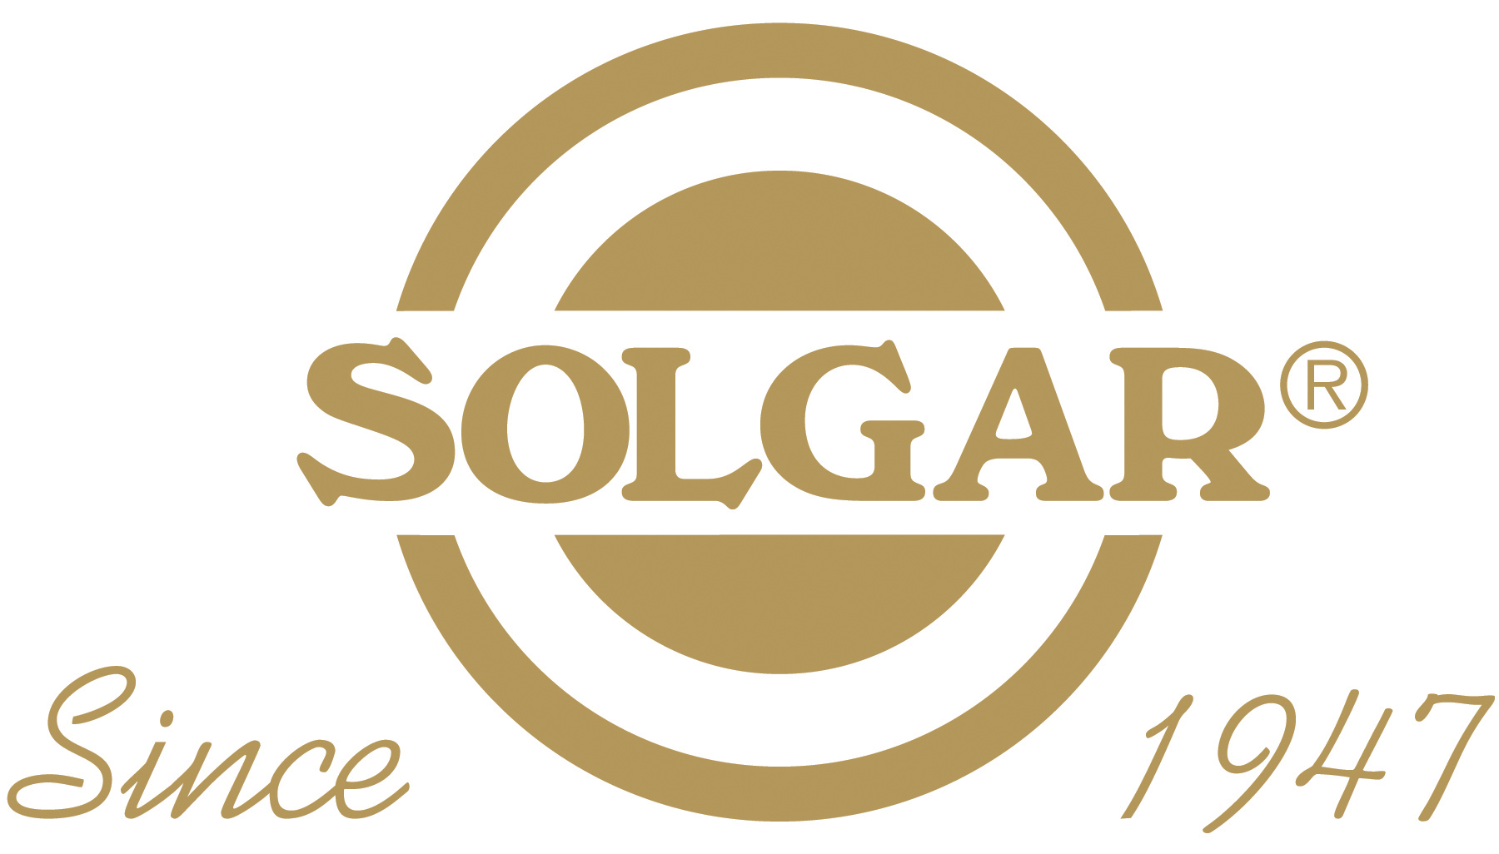
Notes:
Where do all these new products come from? You might notice a few brands that bring some great supplements to market. It is hard to believe that the 14 mega corporations have the same desire to make a person the healthiest they can be naturally. I find that the companies who truly believe this, typically have 1 area of focus or expertise.
Additionally, NEXT I like to take this time and talk about a 4 letter word. Standardization. To make the same thing over and over again, like a drug, you need specific parameters. Standardization requires manipulation of ingredients so there is a specific percentage of an active ingredient. If I want Oleuropein, the most known active ingredient in olive leaf extract, to be at 10%... I need to manipulate multiple batches to make sure my “Natural Product” is manipulated to match my label claims. I recognize humans don’t necessarily know better than nature.

Slide 10
Standardized
Ingredients
Notes:
Where do all these new products come from? You might notice a few brands that bring some great supplements to market. It is hard to believe that the 14 mega corporations have the same desire to make a person the healthiest they can be naturally. I find that the companies who truly believe this, typically have 1 area of focus or expertise.
Additionally, NEXT I like to take this time and talk about a 4 letter word. Standardization. To make the same thing over and over again, like a drug, you need specific parameters. Standardization requires manipulation of ingredients so there is a specific percentage of an active ingredient. If I want Oleuropein, the most known active ingredient in olive leaf extract, to be at 10%... I need to manipulate multiple batches to make sure my “Natural Product” is manipulated to match my label claims. I recognize humans don’t necessarily know better than nature.

Slide 11
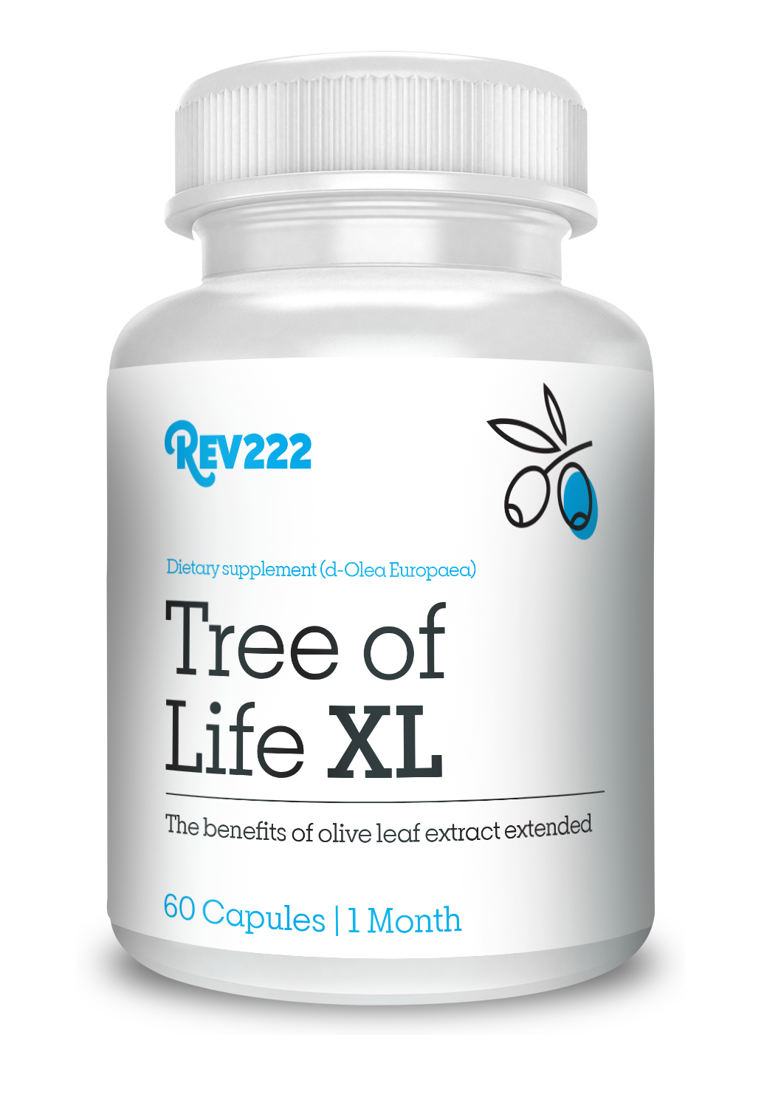

How did they deal with things in ancient times?
Immune System Big Picture
1) Echinacea: Preventing and reducing the duration of the common cold.
2) Elderberry: Fighting flu symptoms and speeding recovery.
3) Colloidal Silver: Antimicrobial properties—but also known for controversy
around safety.
4) Oregano: Powerful natural antibiotic; used to fight infections, especially
respiratory and digestive.
5) Rosemary: Memory support and antioxidant protection.
6) Ginger: Reducing nausea and calming inflammation.
7) Garlic: Heart health and immune support via antimicrobial effects.
8) Vitamins: Supporting overall body function.
9) Probiotics: Supporting gut health and digestion.
10) Olive Leaf Extract: Broad-spectrum antimicrobial action and
reducing viral load.
Notes:
We all know that these items help with your immune system in some way. From Echinacea: Preventing the common cold. Ginger reducing nausea. Oregano: which is a Powerful natural antibiotic to Garlics and heart health. NEXT How did the deal with things in ancient time? I am sure they used all of these items at some point. NEXT We do know that Olive Leaf was their go to. When you would get sick, someone would go out and find an olive branch. They would bring it to you and you would then chew on the leaves. Then spit them out. Chew on the leaves; then spit them out. This would happen over an over. This is why the olive branch is a sign of friendship and peace. NEXT Olive Leaf Extract is REV222 primary focus and our signature product is Tree of Life XL

Slide 12
Olive Leaf Extract: The Heart of Health & Immune
Mission: Science-driven natural health solutions.
Heritage: Innovators of patented d-Lenolate® an olive leaf extract, established in 1995.
Core Values:
  Advanced clinical testing for efficacy.
  Emphasis on immune and overall health benefits.
Signature Product: Tree of Life XL a patented olive leaf extract as d-Lenolate®.
Source: Derived from the leaves of premium olive trees, rich in polyphenols.
Key Benefits:
  Enhances immune system functionality.
  Protects against oxidative stress with high antioxidant levels.
  Supports cardiovascular health by promoting healthy blood pressure.
  Patented olive leaf extract as d-Lenolate® for superior absorption.
Notes:
Necessity is the mother of all inventions. We were founded in 1995 by Gordon Melcher. His son contracted aids in the 80’s. This was a death sentence. However, you did not die from aids, your immune system would become non-existent and a sickness like pneumonia would be your final demise. Hence, Gordon’s desire to boost his son's immune system so he could survive. While he was not successful, he did formulate a new extraction method of olive leaf extract, and he called it d-Lenolate.
Tree of Life XL is Olive leaf extract as d-lenolate, and the heart of health and immune. We have over 30 years of experience… patented ingredients… clinically researched, 100% Natural, and Made in USA. The leaves come from premium olive trees rich in polyphenols. Some of the key benefits of d-Lenolate are its ability to protect against oxidative stress, cardiovascular health, and the immune system functionality. But what is the difference between Tree of Life XL olive leaf extract as d-Lenolate and any other olive leaf extract?

Slide 13
Olive Leaf as d-Lenolate
^{“THE” d-Lenolate} Difference:
Tree of Life XL uses premium olive leaves in our patented extraction process that extends the time your body has to absorb the active ingredient oleuropein from 20 minutes to 8 hours. Our process preserves 18 more active ingredients within the olive leaf and offers daily immune boosting cellular support by protecting against invading microorganisms and increasing white blood cell potency.
Our process has been tested, and clinical studies have demonstrated that d-Lenolate has anti-microbial, fungal, bacterial and viral activities. It is a high-grade olive leaf extract supplement that delivers a potent concentration of Oleuropein to provide natural immune support by working with white blood cells.
WHY TAKE OLIVE LEAF EXTRACT?
d-Lenolate® Olive Leaf Extract is an all-natural herbal supplement shown to help protect against invading micro-organisms that weaken the immune system.
d-Lenolate® stands apart from other olive-leaf extract products on the market due to its patented extraction process.
Notes:
I call this the d-Lenolate difference, starting with our patented extraction process which allows your body to absorb the active ingredients from 20 minutes to 8 hrs. We do this by hiding from the digestion process. We also focus on preserving the full spectrum of ingredients the olive tree leaf has to offer. For example, Oleuropein, Oleuropein is the active ingredient that is directly linked to WBC potency. Most OLE will focus on just this ingredient and then standardize it to 5-10%. We never standardize but we do set a minimum acceptance level of 18%. We also preserve 18 additional active ingredients giving you the full spectrum of what OLE has to offer. One of the new buzz words is hydroxytyrosol. Hydroxytyrosol quiets the cytokine storm that viruses like Covid can trigger. If you are looking for more… here is the REAL d-Lenolate difference… Research and clinical application. We then took d-Lenolate to another level by clinically testing the effectiveness against a mirid of conditions highlighting the anti fungal, bacterial and viral properties. Whether it’s boosting your immunity or promoting heart health, olive leaf extract as plays an essential role in your health and longevity.

Slide 14
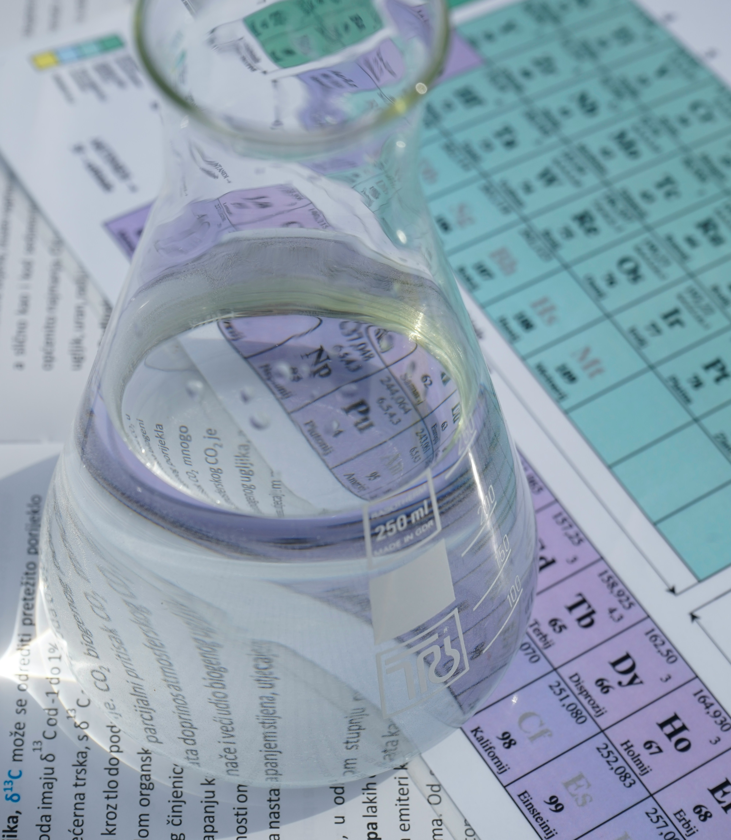
Studies &
Research
The Effect of d-Lenolate® on the Immune Parameters of Humans
Preliminary Testing for Antiviral Properties of d-Lenolate® in Gel Formulation
In-vitro anti-HSV-1 Activities of d-Lenolate® at Different Concentrations
Preliminary Testing of Anti-Viral Properties of d-Lenolate®, Aloe and Neem Tissue Culture Experiments
Analysis of the LSU Safety Letter dated May 11th, 2009
Final Report from Animal Studies with d-Lenolate Formulation for an Effective Herpes Simplex Type 1 Treatment
Evaluation of East Park Research Formulations Containing d-Lenolate® as Antiviral for Effectiveness in Treating Topical Herpes Infections
In-vitro anti West Nile Virus Activities of d-Lenolate®
Antimicrobial Activities of d-Lenolate®
Therapeutic Effect of d-Lenolate® Against Experimental Infections and Immunocompromise Mice. (E coli, Pseudomonas aeruginosa and Candida)
Enhanced Resistance Against Influenza Virus by Treatment with Dietary Supplement d-Lenolate® in Neutropenic Mice Induced by Cyclophophamide
In-vitro Antibacterial Effect of d-Lenolate® Against B. Anthracis
Evaluation of the Efficacy of d-Lenolate® in the Control of Symptoms of Candida Hypersensitivity Syndrome
Effects of d-Lenolate® in Modifying Symptoms of Arthritis
Notes:
Here are a few of the studies we have done over the years. Some that I like to specifically note are: Control of Candida, WITHOUT, changing diet, H1N1 Resistance looking at prophylactic and post infection as well as immunocompromised, WNV, Herpes, HSV and my favorite that we are going to dive into is “The effect of d-Lenolate on the immune parameters of humans”

Slide 15
Immune System
Macro: Big Picture
Micro: Small Picture
Notes:
To look at this study, we must look at the micro side of your immune system.

Slide 16
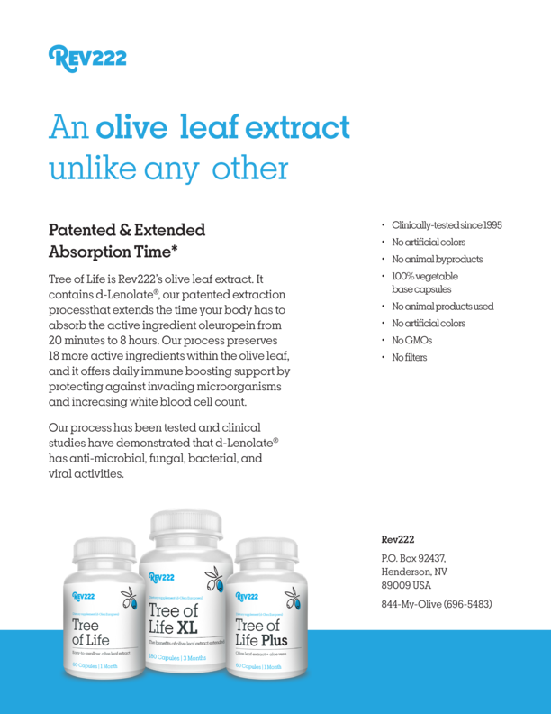
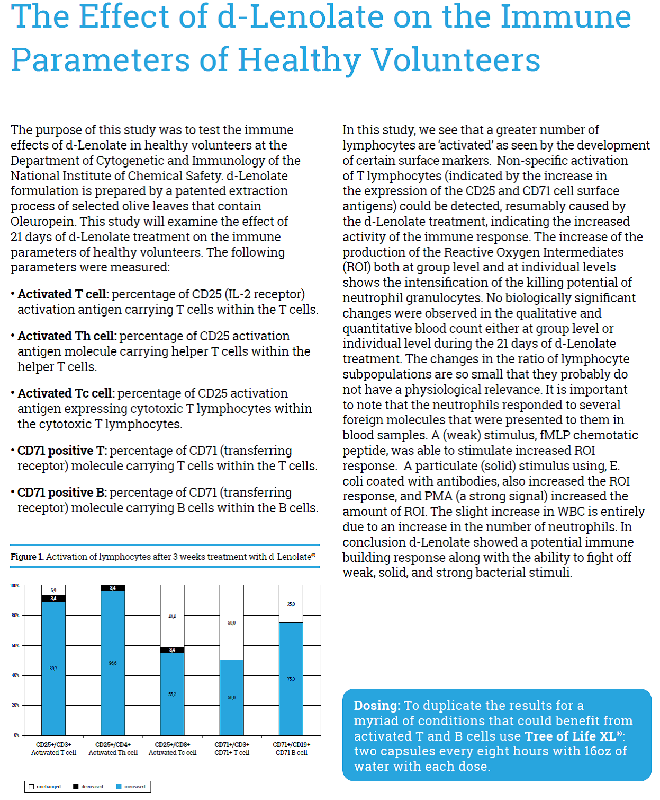
Notes:
Here is a copy of our “WHITE” sheet for Tree of Life XL. You can also download a copy along with these slides in the presentation portal. We are going to focus on the right side where all the results are.

Slide 17
Download slides and watch presentation!
REV22-2.com/presentation/
Notes:
Here is the QR code or web address for a copy of our “WHITE” sheet. I will wait just a few seconds more.

Slide 18
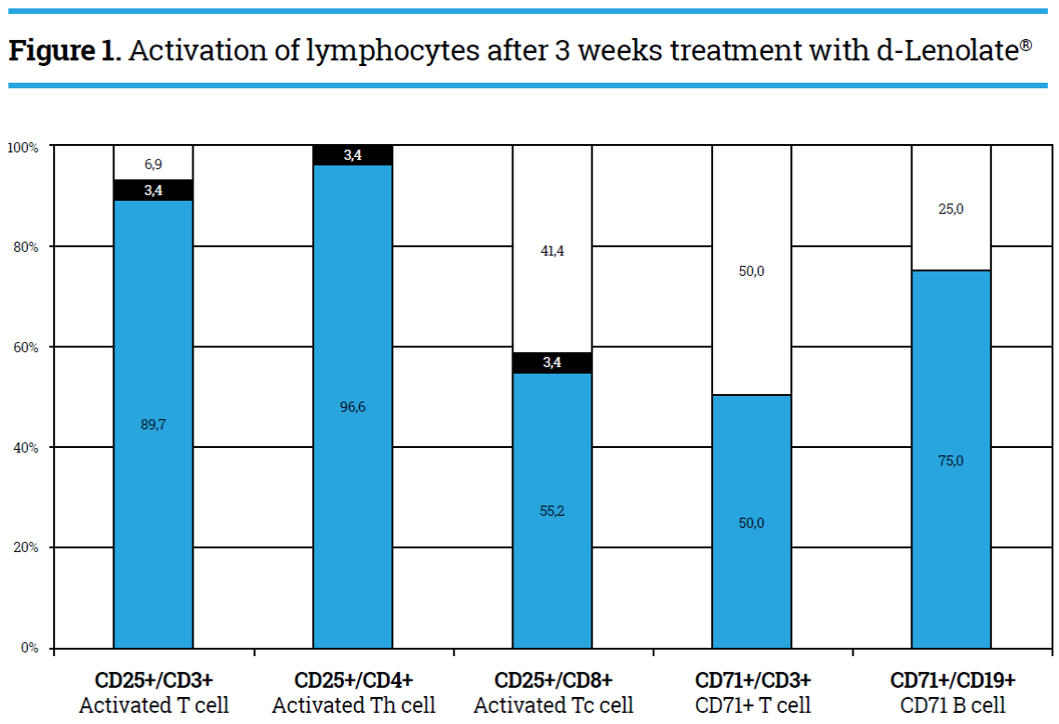

Effect of d-Lenolate on the Immune Parameters of Healthy Volunteers
T cells are a major component of an adaptive immune system.
Roles include directly killing infected host cells, activating other immune cells, producing cytokines and regulating the immune response.
CD25 is considered the most prominent cellular activation marker.
CD3 is a component of our immune signal response associated with T-cell
CD4 distinguishes T-helper cells
CD8 distinguishes T-cytotoxic cells
CD71 is a transferrin receptor that mediates the uptake of transferrin-iron complexes.
CD19 establishes intrinsic B cell signaling thresholds
Notes:
The effect of d-lenolate on the immune parameters of healthy volunteers. T cells are a major component of having an adaptive immune system. The T cells are directly responsible for killing infected host cells, activating other immune cells and providing an immune response. CD25, CD3, 4, 8, 71, and 19 are markers that we looked at to tell us if we were creating an adaptive immune system.
Look at the graph, Do you see how most markers show an increase, decrease and an unchanged portions. This is because Olive Leaf Extract is an immune modulator. An underactive immune system, we see an increase. Overactive immune system we see a quieting effect of the immune system. NEXT: Notice the circled portion, The Th or helper cells, The TH cells “Coach” or activate B cells telling them when and how to make antibodies. Now your body WBCs are like packman going around eating pathogens they encounter. They don’t need to trigger a huge immune response… leaving the rest of your body unprotected. This is how an immunocompromised persons body reacts! . . . Being immunocompromised is a thing of the past.

Slide 19
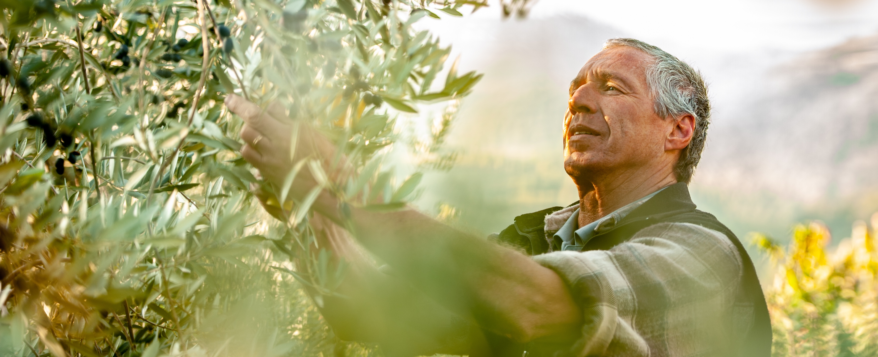

Immune System Micro
Olive Leaf Extract as
d-Lenolate
?
Notes:
OLE with its WBC activation and antiviral properties cover the immune system on the Micro level. Lets take this one step further to enhance the OLE.
???We’ve got the micro what to add to cover the macro and enhance the OLE?

Slide 20
How did they deal with things in ancient times?
1) Echinacea: Preventing and reducing the duration of the common cold.
2) Elderberry: Fighting flu symptoms and speeding recovery.
3) Colloidal Silver: Antimicrobial properties—but also known for controversy
around safety.
4) Oregano: Powerful natural antibiotic; used to fight infections, especially
respiratory and digestive.
5) Rosemary: Memory support and antioxidant protection.
6) Ginger: Reducing nausea and calming inflammation.
7) Garlic: Heart health and immune support via antimicrobial effects.
8) Vitamins: Supporting overall body function.
9) Probiotics: Supporting gut health and digestion.
10) Olive Leaf Extract: Broad-spectrum antimicrobial action and
reducing viral load.
Notes:
We already have OLE. NEXT Oregano… Oregano is known for its direct ability to fight infections, especially respiratory and digestive. Oregano takes more of a Macro approach to immunity.

Slide 21
When you think about Oregano what do you think about?
1. Culinary Uses
Mediterranean and Italian cooking – especially in pizza sauce, pasta, and grilled meats.
Aromatic and earthy flavor – it has a slightly bitter, pungent taste that adds depth to food.
2. Health Benefits
Immune support – often associated with anti-fungal and anti-bacterial properties.
Oil of oregano – a potent supplement used for colds, gut health, and inflammation.
3. Herbal & Natural Medicine
It's often part of traditional remedies, especially in naturopathic and folk medicine.
Tied to gut health, respiratory issues, and anti-fungal treatments.
4. Fragrance and Identity
Strong, warm, herbal scent – sometimes described as camphor-like.
Feels very “earthy” and wild – evokes natural, untamed landscapes or gardens.
Notes:
“What do you think about when you think Oregano? Without question PIZZA… or pasta!
It also checks a lot of boxes with regards to health benefits. It has Anti-Fungal and Anti-Bacterial properties. It is also used for Gut Health, Respiration and Inflammation issues. Even thought it is in a capsule and sealed.. It still has a strong warm herbal scent.

Slide 22
Oregano as P-73
Source:
  Grown in high-mountain, mineral-rich soil for potency.
Key Benefits:
  Antimicrobial properties to combat harmful pathogens.
  Antioxidant protection against free radicals.
  Anti-inflammatory action for joint and muscle health.
  The P-73 formula is uniquely potent and pure.
Notes:
Oregano as P73 has the health benefits from the previous slide, it is Anti-Fungal, Anti-Bacterial and anti-inflammatory. In addition, it has anti-microbial and anti-oxidant protection against free radicals.
The P73 formula is uniquely pure and potent.

Slide 23
P-73 Difference:
Active Ingredients
Most oreganos have 6
P-73 wild oregano has 30
Carvacrol: The primary active compound.
  Known for antibacterial, antifungal, and anti-inflammatory effects.
Thymol
  Another potent antiseptic and antifungal compound.
  Supports immune health and works synergistically with carvacrol.
Rosmarinic Acid
  A powerful antioxidant.
  Helps reduce oxidative stress and inflammation.
Terpenes (e.g., pinene, terpinene)
  Contribute to the aroma and may have antioxidant and bronchodilating properties.
Flavonoids (e.g., luteolin, apigenin)
  Offer antioxidant benefits and support cellular health.
Ursolic Acid
  Has been studied for anti-inflammatory, anti-cancer, and antimicrobial properties.
Carvacrol
Para Cymen
Linalool
Trans Caryophyllene
Gamma Terpinen
Thymol
Borneol
Alpha Terpinen
Alpha Pinene
Beta Myrcene
1,8 Cineol
Caryophyllene oxide
Aromadendren
Beta fenchylalcohol
Camphene
1-Octon 3-Ol
Beta Bisabolene
Limonene
Spathulenol
Alpha terpinolene
Alpha Phellandrene
Beta Pinen
Alpha humulene
Carvon
Gamma Cadinen
Delta 3 Caren
Delta Cadinen
Trans linalool oxide
Para Cymen-8-ol
3-Octanol
Notes:
Why? The real difference… Active Ingredients. Active Ingredients and the ability to retain as much of nature as possible. Retaining the full spectrum of what oregano has to offer.
Just like with oleuropein and OLE, CAR-vah-crawl is typically the active ingredient companies look for because of its antimicrobial and fungal properties. But standardizing or focusing on one ingredient, you miss all that the plant has to offer. As I began to learn about oregano, it had one major side effect. It is not recommended for daily consumption. This was going to be an issue because our protocols can sometime last 6 months.

Slide 24
^{“THE”}
Oregano P-73 Difference:
The wild, handpicked, Mediterranean oregano!
only daily use,
Thymol
Potency: At higher levels, thymol can irritate mucous membranes and the digestive tract.
Toxicity risk: Chronic high intake can stress the liver or kidneys.
Disruption of microbiome: Strong antiseptic compounds can disrupt beneficial gut flora if taken in excess.
Regulatory caution: Many health agencies set limits on thymol intake because of these risks.
Wild-source oregano oil: P-73 has a natural spectrum of compounds, not isolated thymol.
Balanced profile: In P-73, thymol content is deliberately kept very low (typically <2%) while carvacrol is much higher.
Safe daily use: Because thymol is naturally present only in trace amounts, it avoids the irritation and toxicity concerns seen with concentrated thymol.
Synergy of compounds: The full plant extract (including carvacrol, flavonoids, and other phenolics) has balancing effects, making it gentle but effective for long-term support.
Notes:
P73 was making a claim that it is the only edible daily use, WILD, handpicked oregano. How? NEXT Thymol. Thymol, in other oregano extracts have higher levels of thymol that disrupt the mucous membranes and digestive tract. Chronic high intake also stresses the liver and kidneys. What is high? Italy variety has up to 56% and Mexican oregano has 14-16% thymol.
Typically, high levels of CAR-vah-crawl also give you high levels of Thymol. If the push is for the highest levels of CAR-vah-crawl then one would also expect high levels of thymol.
Thymol is GRAS below 2% for daily use. P73 is typically below 1% but has a minimum standard of less than 2%. What was I missing out by having a low level of Thymol. Thymol works directly on the immune system, and I know OLE has that covered.

Slide 25
P-73 Difference:
The wild, handpicked, Mediterranean oregano!
only daily use,
The wisdom derived from years of tradition and countless scientific investigations is the foundation for the first and only original wild oil of oregano extract. That is why oregano as P-73 is the unmatched leader in quality and power.
Notes:
The P73 Difference, The only edible daily use, WILD, handpicked, mediterranean oregano. With the wisdom derived from years of tradition it is the unmatched leader in quality and power.

Slide 26
Full Spectrum Immune Support
Macro: Big Picture
Micro: Small Picture
P-73
d-Lenolate
Notes:
Yes, we know there are lifestyle changes that will help improve our immune system, but for a full spectrum immune support supplement, P73 covers the direct contact or macro portion of your immune system… NEXT while d-Lenolate boost your immune system on a micro or cellular level.

Slide 27
Oregano
as
P73
Full Spectrum Immune Support
Olive Leaf Extract as
d-Lenolate
Living Better Through ”Nature”
Notes:
Lets see what it looks like to live better through nature with a full spectrum immune support supplement.

Slide 28
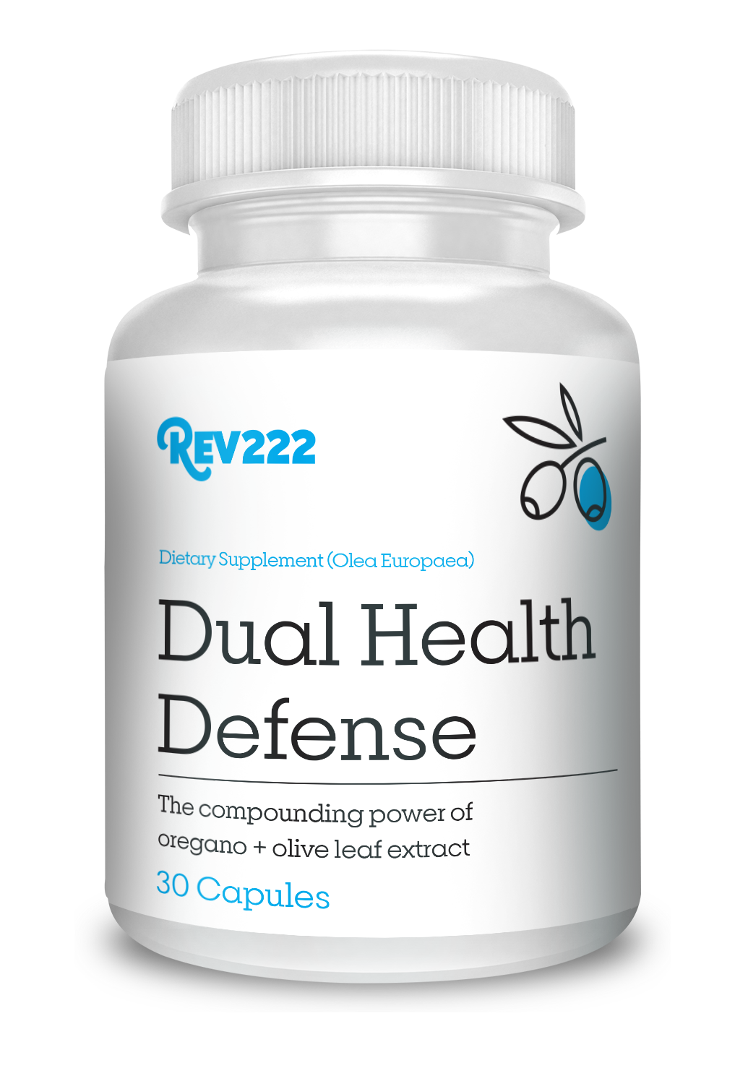
Full Spectrum Immune Support
Why They Work Together:
  Wild oregano oil provides immediate immune defense.
  Olive leaf extract offers long-term immune and cardiovascular support.
  Together, they create a balanced approach to health.
Benefits of Synergy:
  Faster results due to oregano’s potent compounds.
  Sustained support from olive leaf extract’s ongoing action.
Scientific Backing:
  Research shows combined usage amplifies individual effects.
Features:
  High-quality, sustainably sourced ingredients.
  Free from additives, fillers, and synthetic substances.
  Packaged in environmentally friendly materials.
Benefits:
  Immune system boost.
  Antioxidant protection.
  Anti-inflammatory and cardiovascular support.
Notes:
We get the P73 providing immune defense and the d-Lenolate offering the long term immune and cardiovascular support. Building a balanced approach to immune health. We have already seen quicker results with acute issue compared to the Tree of Life XL by itself. All the high quality ingredients are sustainably sourced and free from additives, fillers, synthetic substances and is never standardized. We have reviewed the science and what we expect to happen… lets take a look at real life.

Slide 29
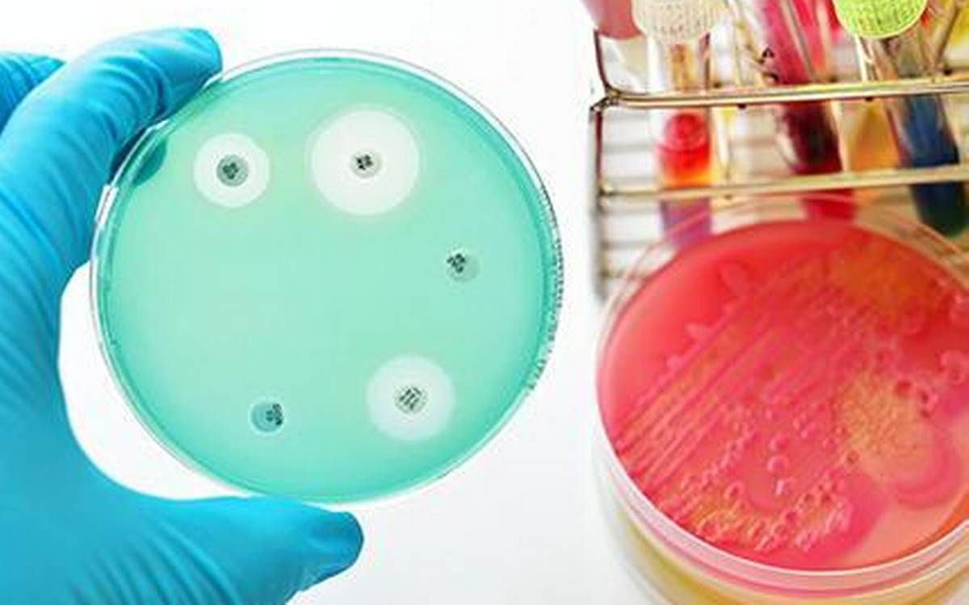
Real World Issues: Bacteria/Fungal
Recommended Dosing:
Maintenance: 1-2 capsules daily
First Sign of an Infection: 1 capsule 3 times daily
Chronic Infection Recommended Dosing:
1 capsules 3 times daily Tree of Life XL
1 capsules 3 times daily Dual Health Defense
Additional Recommendations:
Water, minimum of 32oz daily with a pinch of sea salt/pink; adding squeezed lemon, up to a whole lemon per 32 ounce bottle and a good probiotic.
Notes:
Specifically, dual defense is going to be for those patients that have reoccurring fungal or bacterial issues. Maintenance is going to be 1 – 2 capsules daily; at the first sign of infection start on 1 capsule 3 times daily. We are going to recommend 32oz of water with a pinch of sea salt, juice from a lemon and a good probiotic. Unfortunately, most people will not start on something unless they have an issue they want resolved. Therefore, lets look at the chronic dosing.

Slide 30
Real World Issues: Bacteria/Fungal
Chronic Infection Recommended Dosing:
1 capsules 3 times daily Tree of Life XL
1 capsules 3 times daily Dual Health Defense
The more chronic the situation, the longer it may take to see
a sustained effect. It is not at all unusual to see a dramatic
"improvement" within 24-48 hours, only to have it "stop working" (from the patient's perspective). That is completely normal, though it does not occur in every case. Again, the longer the protocol is followed, the better the outcome will be.
Additional Recommendations:
Water, minimum of 32oz daily with a pinch of sea salt/pink; adding squeezed lemon, up to a whole lemon per 32 ounce bottle and a good probiotic.
Notes:
Chronic issues tend to be the result of immunocompromised individuals. Tree of Life XL boosts your immune system on that cellular level; taking the patient from immuocomprmised to a properly functioning immune system. This will eliminate the chronic infection in time, however, adding Dual Health Defense will decreased the duration of symptoms. This protocol is designed specifically for fungal and bacterial conditions. I would like to note that it is not unusual for the patient to dramatically improve within the first 48hrs to then see a plateau from the patients perspective… this is normal, and not in every case. Lets see where to use this dosing.

Slide 31
Health Conditions by Name
Arthritis – Certain forms, such as septic arthritis (fungi), and reactive arthritis (bacterial infections in the gut or urinary tract).
Asthma – Can be worsened by fungal sensitization or bacterial respiratory infections.
Bell’s Palsy – Often viral, but some cases linked to Lyme disease (bacterial, Borrelia burgdorferi).
Bronchitis / Sinusitis – Frequently bacterial (Mycoplasma, Bordetella pertussis, Haemophiles influenzae) or fungal in chronic/immunocompromised cases.
Candida – Directly fungal (overgrowth of Candida albicans).
Heart Disease – Infective endocarditis (bacterial or fungal infection of heart valves). Chronic periodontal (bacterial) infections increase cardiovascular risk.
Lyme Disease – Can cause long-term joint, neurological, and cardiac issues.
Periodontitis – Chronic gum disease.
Pancreatitis – Usually alcohol or gallstones, but secondary infections (bacterial/fungal) can complicate acute necrotizing pancreatitis.
Restless leg syndrome – Mostly neurological/iron-related; indirect link if secondary to chronic infections or inflammation.
Tuberculosis – Classic chronic infection affecting lungs, can remain latent for decades.
Vaginitis – Can be bacterial (bacterial vaginosis, Gardnerella vaginalis), fungal (Candida vaginitis), or even protozoal (Trichomonas).
Notes:
Health Conditions, Asthma, bronchitis, sinusitis, candida, Lyme disease, vaginitis,
I was a little surprised by the Restless leg syndrome and arthritis. I thought this would be mechanical or neurological problem. However, I could not deny the number of reports where these issues were resolved.

Slide 32
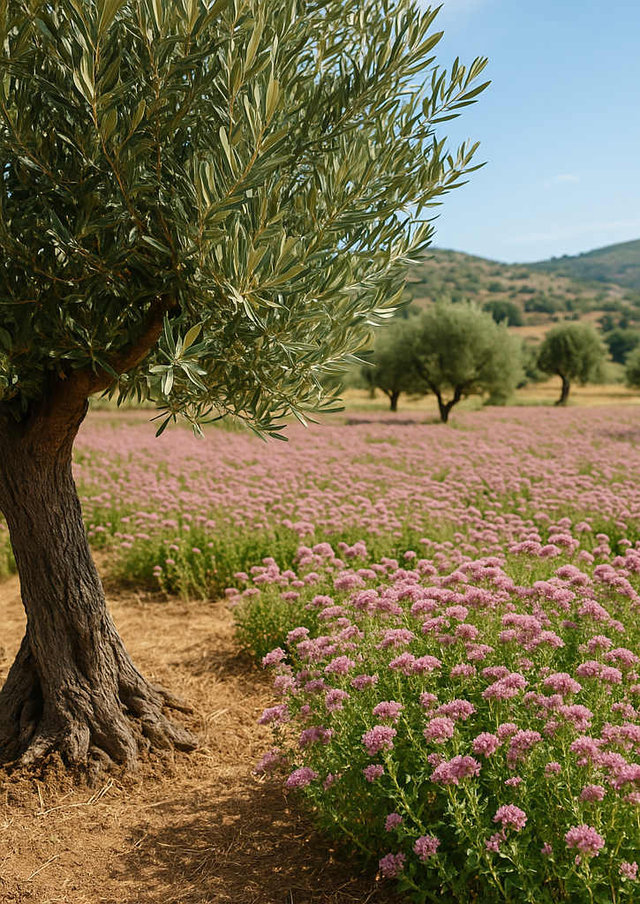
Fungal & Bacterial Medications
Rank | Drug Name | Class | Year Introduced | Common Uses
1 | Fluconazole (Diflucan) | Triazole | 1990 | Yeast infections (oral, vaginal), systemic candidiasis, thrush
2 | Terbinafine (Lamisil) | Allylamine | 1991 (oral) | Nail fungus, athlete’s foot, ringworm
3 | Itraconazole (Sporanox) | Triazole | 1992 | Toenail/fingernail fungus, histoplasmosis, blastomycosis
4 | Griseofulvin | Antifungal Antibiotic | 1958 | Scalp ringworm, tinea infections in children
5 | Ketoconazole (oral) | Imidazole | 1981 (oral form) | Systemic fungal infections (rare due to liver toxicity)
A Synergistic Blend of Nature’s Finest: Wild Oregano and Olive Leaf Extract
Rank | Drug Name | Class | Year Introduced | Common Uses
1 | Amoxicillin | Aminopenicillin | 1972 | Ear, sinus, throat, respiratory, UTI
2 | Amoxicillin-Clavulanate (Augmentin) | Beta-lactam + inhibitor | 1981 | Sinusitis, bronchitis, resistant bacterial infections
3 | Azithromycin (Z-Pak) | Macrolide | 1988 | Respiratory infections, STIs, traveler's diarrhoea
4 | Doxycycline | Tetracycline | 1967 | Acne, Lyme disease, chlamydia, MRSA, malaria prophylaxis
5 | Trimethoprim-Sulfamethoxazole (Bactrim) | Sulfonamide combo | 1968 | UTIs, MRSA, bronchitis, Pneumocystis jirovecii pneumonia
Notes:
Typically, these issue are delt with by using these meds. The top box are the most common fungal medications. The bottom box are the most common bacterial medications. Dual Health Defense has the potential to replace this entire list. Please note, there is a time and a place for antibiotics and medication. The overuse of antibiotics and medications is part of the continued pandemic that is taking over the modern world. It does seem a little crazy that all these medications were invented before Google and Wi-Fi.

Slide 33
Health Conditions by Symptoms
Ear, sinus, throat, and respiratory infections
Urinary tract infections (UTIs)
Respiratory infections (bacterial and fungal)
Skin and nail fungal infections (athlete’s foot, ringworm, ringworm)
Yeast infections (oral, vaginal), thrush,
Sexually transmitted diseases (STDs)
Acne
Gum disease / oral infections
Systemic Lung infections (Histoplasmosis, blastomycosis, cryptococcosis)
Systemic fungal infections (severe/rare, e.g., in immunocompromised)
Recommended Dosing:
Maintenance: 1-2 capsules daily
First Sign of an Infection: 1 capsule 3 times daily
Chronic Infection Recommended Dosing:
- 1 capsules 3 times daily Tree of Life XL
- 1 capsules 3 times daily Dual Health Defense
Notes:
I did not want to put “when” to use Dual Health Defense in a long list of “NAMED” conditions such as Lyme disease. Here is a list of symptoms where you can know that adding Dual Health Defense is going to at least start… if not eliminate the symptoms. Rarely are we going to start the person on a maintenance does or first sign of infection dosing. I do recommend 30-60 days at the chronic infection dosing. Do not be surprised to see results in less than 30days. However, keep them on the dose to minimize the potential for relapse and allow for the immune system to become adaptive.

Slide 34
Why Choose Dual Health Defense:
Features:
  High-quality, sustainably sourced ingredients.
  Free from additives, fillers, and synthetic substances.
  Packaged in environmentally friendly materials.
Benefits:
  Immune system boost.
  Antioxidant protection.
  Anti-inflammatory and cardiovascular support.
Quality Assurance:
  Manufactured in GMP-certified facilities.
  Third-party tested for potency and purity.
Product Sizes
Quantity: 30 Capsules
Wholesale Price: $ 17.23
Retail Price: $ 34.99 - $44.99
SKU: R-OD1
Product Size: 1.75” x 3.0” x 1.75”
Quantity: 90 Capsules
Wholesale Price: $ 49.95
Retail Price: $ 79.99 - $99.99
SKU: R-OD90
Product Size: 2.5” x 4.5” x 2.5”
Notes:
The product does come in two sizes. I would like to point out the retail price. You will see there is a range. First, it is important to understand that all REV222 products are only available to approved practitioner or health provider accounts. If you received an email directly or viewed this presentation in person, then you have been qualified for an account. Second, the range is designed to give you an idea of where to price the product depending on your business model. Additionally, REV222 products are not sold amazon keeping your patients coming back to you.
Dual Health Defense is our answer to the new era of immune support for the 21st century immune system and diseases.

Slide 35
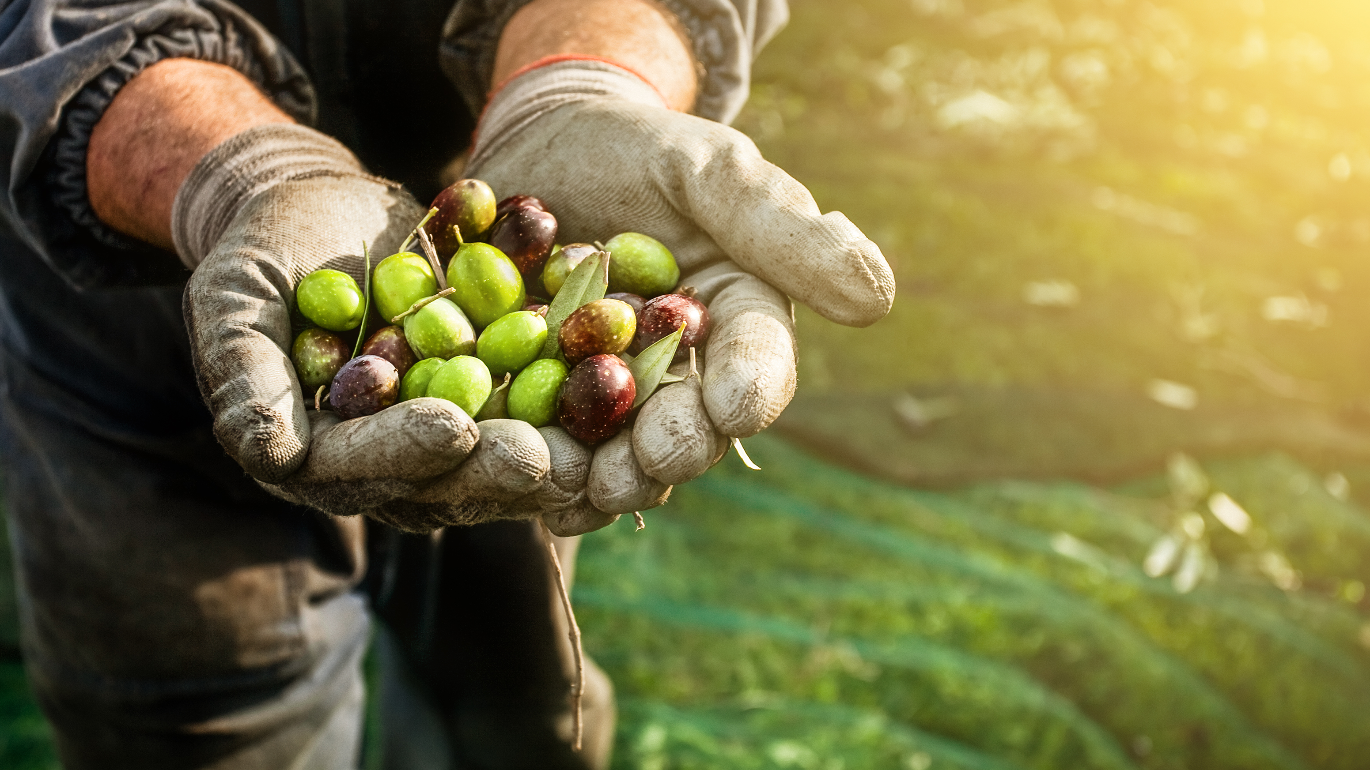
Thank You!
Help Us Tell The World
Title: What’s Driving the Immune Health Shift
Notes:
Thank you for taking the time to become an expert by learning what is driving the immune health shift and the new era of immune defense.

Slide 36
Download slides and watch presentation!
REV22-2.com/presentation/
Notes:
Here is the QR code and web address one more time for the presentation and “WHITE” sheet.

Slide 37

Quick Checkout!
In the order notes put…
“Create Account”
QUESTIONS?
info@REV22-2.com
Notes:
REV222 gives you the control to place orders directly. BUT… you must be logged in to add products to your cart and check out. That can sometimes be difficult when you just want to put in an order. The QR code allows you to bypass the login or create an account process. If you have an account or want account, please put create account in the order notes and we will do the heavy lifting. Please note that the QR code allows you to place one order and all other orders will result in a review status before the order is shipped. If you want to see the full product line, please go to www.REV22-2.com and if you have questions, please email info@rev22-2.com have a wonderful day and stay healthy.

