Slide 1

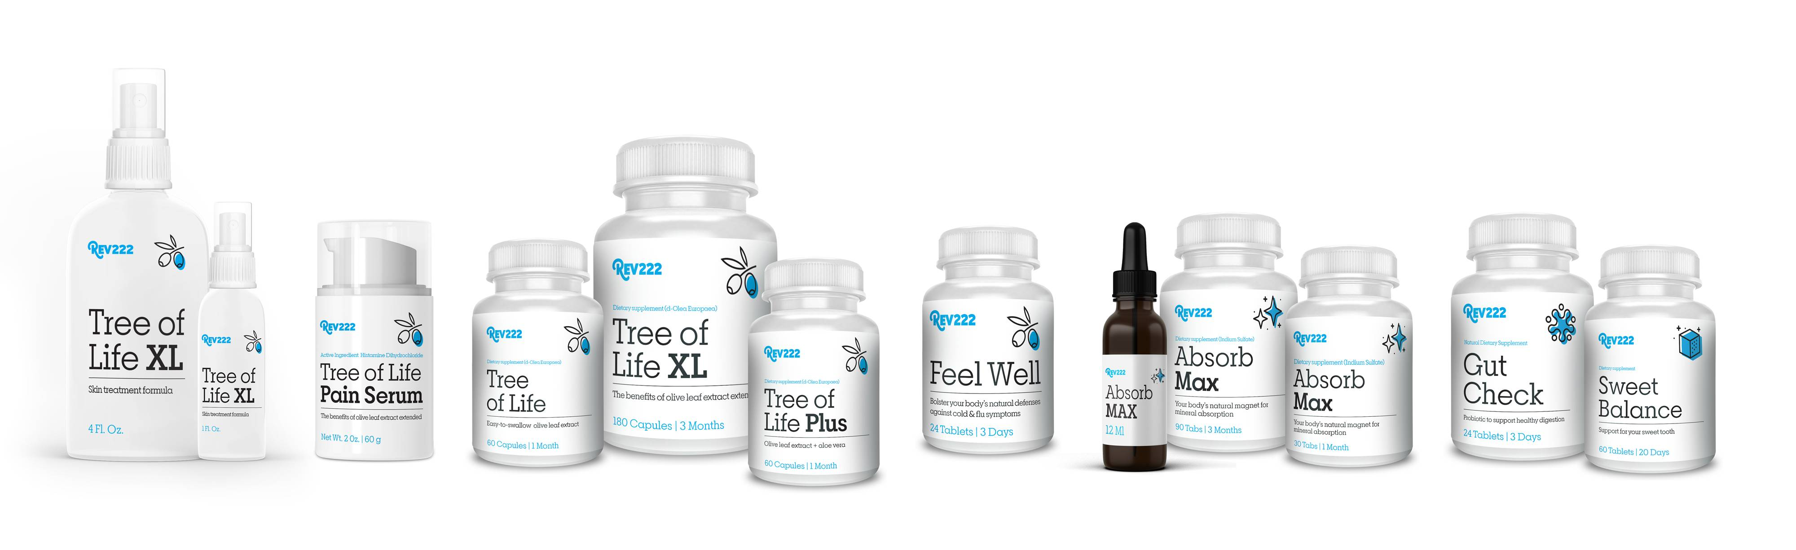
Hydroxytyrosol:
Little Known Secret of the Olive Tree
by
Geoff Melcher MS

Slide 2

Who We Are & Why We’d Be Proud to Work With You
About Us:
Founded in 1995.
Manufactured in USA.
Creators of the patented Olive Leaf Extract product d-Lenolate.
Products are gluten free & non-GMO.
We are passionate supporters of the veteran's community on both a nation and international level.
Rev22-2 Philosophy's:
We are commitment to socially responsible, lawful and ethical business practices.
We believe creating healthy communities starts by supplying them with the best products on the market.
6

Slide 3
An olive leaf extract unlike any other!
Clinically-tested since 1995
No artificial colors
No animal byproducts
100% vegetable base capsules
No GMOs
No fillers
Patented & Extended Absorption Time
Tree of Life is Rev222’s olive leaf extract. It contains
d-Lenolate, our patented extraction process that extends the time your body has to absorb the active ingredients from 20 minutes to 8 hours. Our process preserves 18 more active ingredients within the olive leaf, and it offers daily immune boosting support by protecting against invading microorganisms and increasing white blood cell potency.
Our process has been tested and clinical studies have demonstrated that d-Lenolate® has anti-microbial, fungal, bacterial and vial activities.
6

Slide 4
Studies & Research
The Effect of d-Lenolate® on the Immune Parameters of Humans
Preliminary Testing for Antiviral Properties of d-Lenolate® in Gel Formulation
In-vitro anti-HSV-1 Activities of d-Lenolate® at Different Concentrations
Preliminary Testing of Anti-Viral Properties of d-Lenolate®, Aloe and Neem Tissue Culture Experiments
Analysis of the LSU Safety Letter dated May 11th, 2009
Final Report from Animal Studies with d-Lenolate Formulation for an Effective Herpes Simplex Type 1 Treatment
Evaluation of East Park Research Formulations Containing d-Lenolate® as Antiviral for Effectiveness in Treating Topical Herpes Infections
In-vitro anti West Nile Virus Activities of d-Lenolate®
Antimicrobial Activities of d-Lenolate®
Therapeutic Effect of d-Lenolate® Against Experimental Infections and Immunocompromise Mice. (E coli, Pseudomonas aeruginosa and Candida albicans)
Enhanced Resistance Against Influenza Virus by Treatment with Dietary Supplement d-Lenolate® in Neutropenic Mice Induced by Cyclophophamide
In-vitro Antibacterial Effect of d-Lenolate® Against B. Anthracis
Evaluation of the Efficacy of d-Lenolate® in the Control of Symptoms of Candida Hypersensitivity Syndrome
Effects of d-Lenolate® in Modifying Symptoms of Arthritis
6

Slide 5
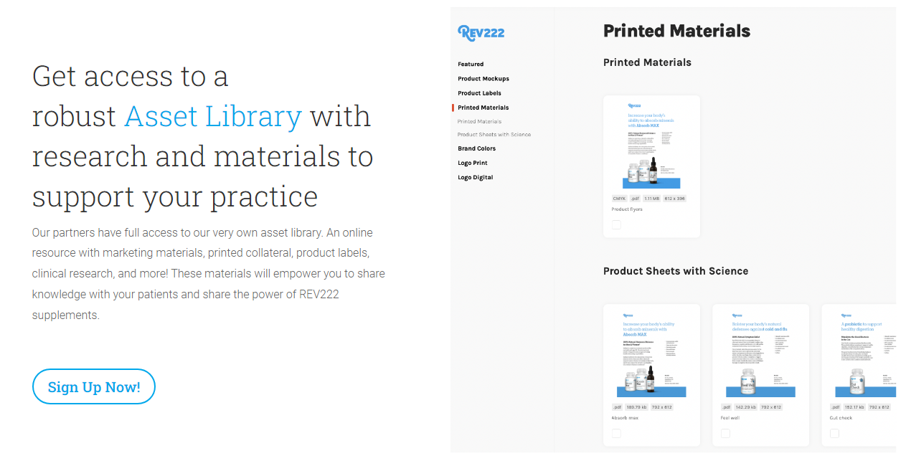
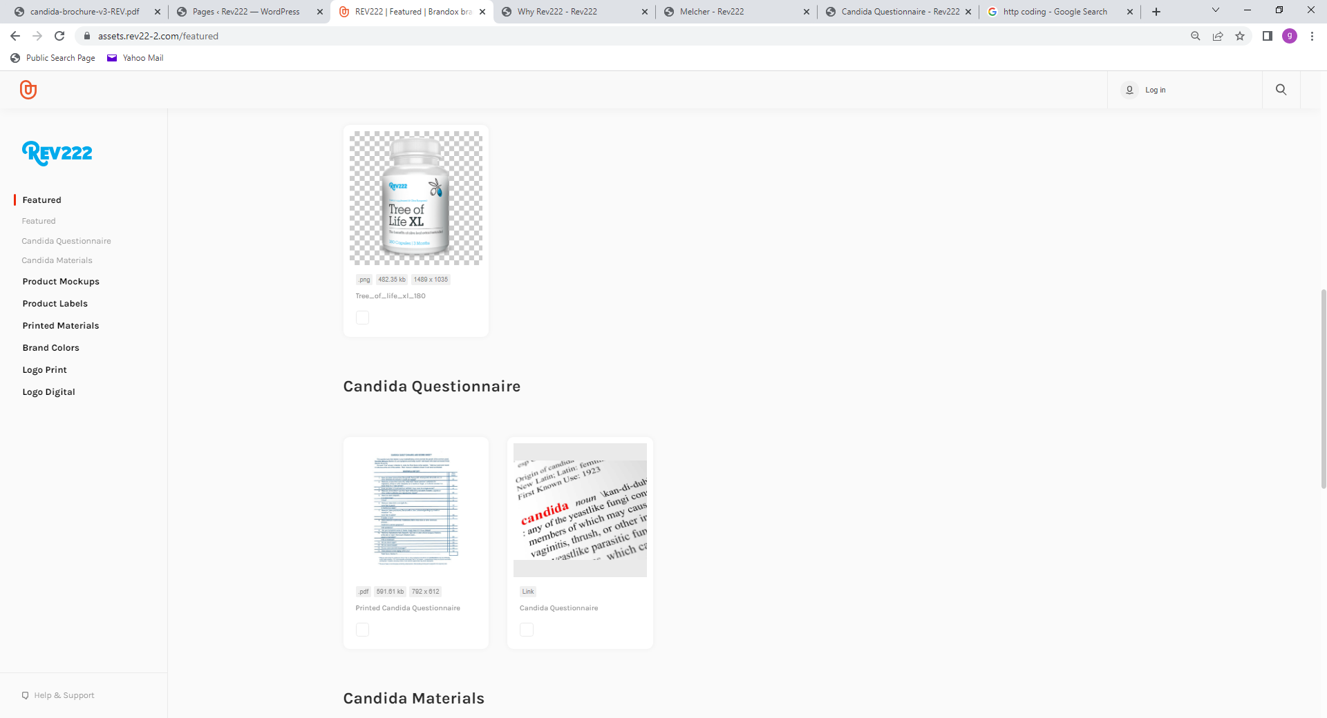
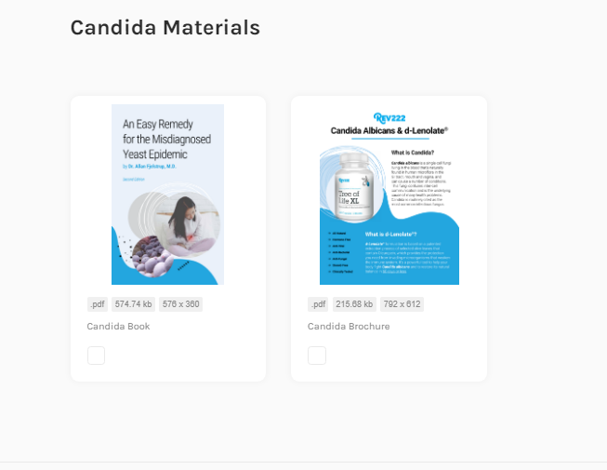
Assets available to you at any time!
Click and Download
We have 4 options for you once you create an account:
Print the questionnaire and have the patient complete on their own.
Login and go through the questionnaire with the patient.
Have your own private link that we host for you. The results get sent to you directly.
Add it to your own web page. We send you the API.
Assets.Rev22-2.com
6

Slide 6
White Sheets
Assets.Rev22-2.com
6

Slide 7
White Sheets
Assets.Rev22-2.com
6

Slide 8
White Sheets
Assets.Rev22-2.com
6

Slide 9
White Sheets
Assets.Rev22-2.com
6

Slide 10
White Sheets
Assets.Rev22-2.com
6

Slide 11
White Sheets
Assets.Rev22-2.com
6

Slide 12
The Effect of d-Lenolate on the Immune
Parameters of Healthy Volunteers
T cells are a major component of an adaptive immune system.
Roles include directly killing infected host cells, activating other immune cells, producing cytokines and regulating the immune response.
Activated T cell: activation antigen carrying T cells within the T cells.
Activated Th cell: activation antigen molecule carrying helper T cells within the helper T cells.
Activated Tc cell: activation antigen expressing cytotoxic T lymphocytes within the cytotoxic T lymphocytes.
CD71 positive T: transferring receptor molecule carrying T cells within the T cells.
CD71 positive B: transferring receptor molecule carrying B cells within the B cells.
6

Slide 13
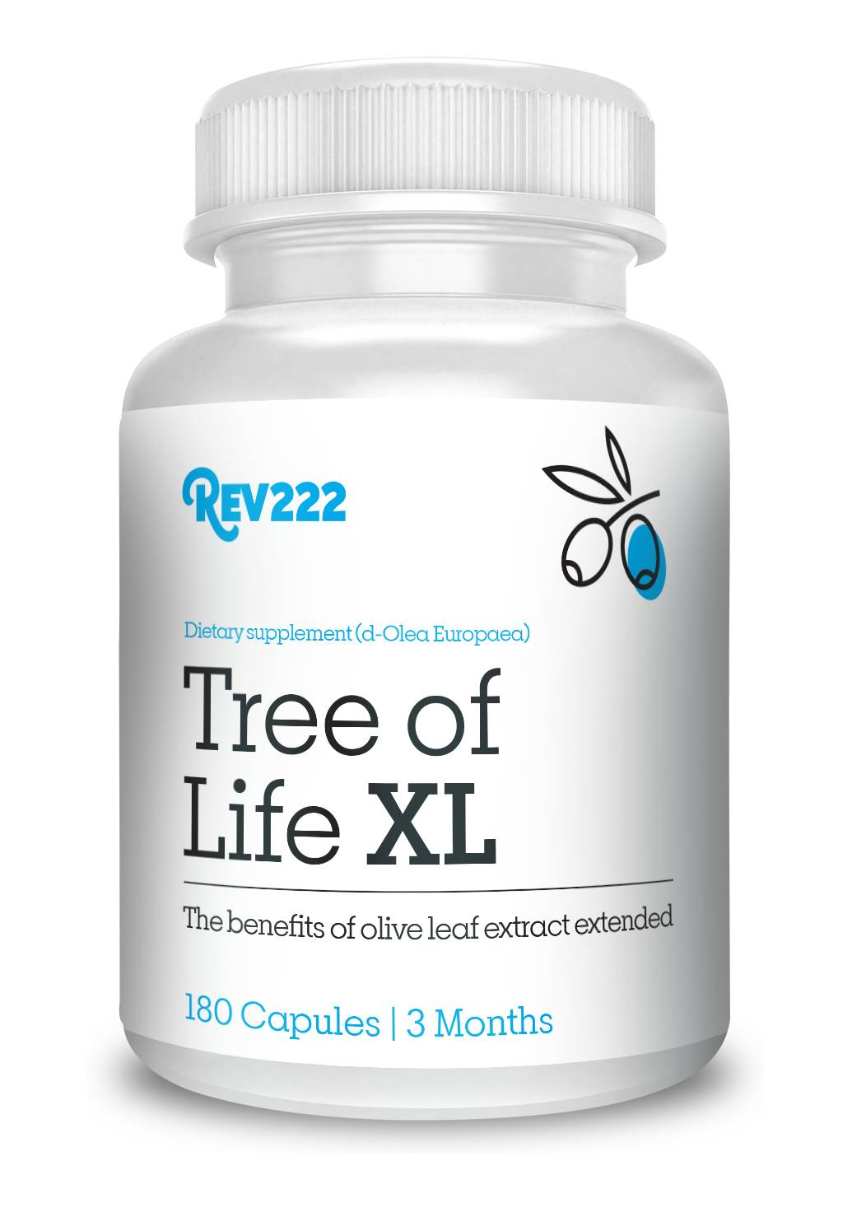
An olive leaf extract unlike any other!
Preserving 18 MORE active ingredients.
We control every step of the manufacturing process.
We test the leaves from the tree.
We test the liquid in the extraction process.
We test the powder from the drying process.
We test the capsules from the bottling process.
We are in control of every step of the process and look for specific markers. Hence, 18 MORE active ingredients.
Olive leaves are widely used in natural medicine with beneficial effect on health care due to their bioactive properties. Olive leaf extract contains large amounts of polyphenolic compounds that include oleuropein and flavonoids with antioxidant, anti-inflammatory and
antimicrobial properties.
How did we get here? Let's look at the Mediterranean diet.
Clinically-tested since 1995
No artificial colors
No animal byproducts
100% vegetable base capsules
No GMOs
No fillers
6

Slide 14

18 MORE Active Ingredients:
Hydroxytyrosol
The Mediterranean diet has been associated with a minor risk of cardiovascular diseases and cancer. Particularly, olive oil plays a key role in these benefits, due to its composition of fat, richness in monounsaturated fatty acids (oleic acid) and other micronutrients.
6

Slide 15
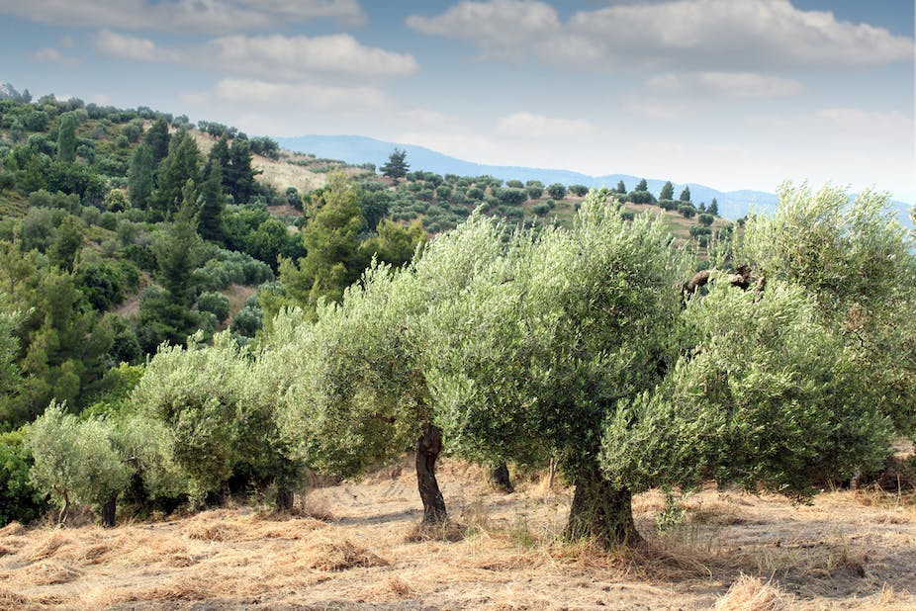
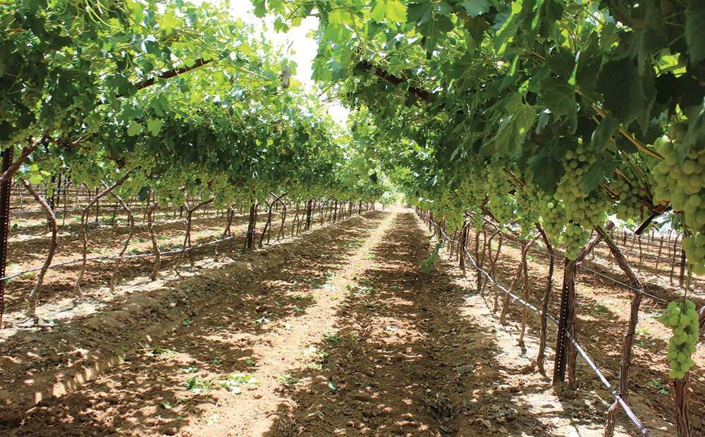
18 MORE Active Ingredients:
Hydroxytyrosol
A very common active ingredient that most of you have probably heard of is oleuropein. A less common ingredient that over the past year has gotten more and more notoriety is Hydroxytyrosol.
Hydroxytyrosol is one of those micronutrients. It is a potent antioxidant from extra virgin olive oil and olives. We know that there is great variability in the nutrients given to the olives and the leaves. This molecule may be the secret of the Mediterranean diet. The typical Spaniard nets about 5.6mg daily of Hydroxytyrosol.
The variability is due to altitude, latitude, variety of olive tree, the harvesting and processing conditions.
6

Slide 16
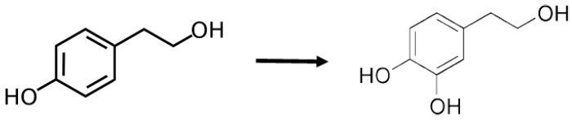
Hydroxytyrosol:
Most Potent Natural Antioxidant Know
Hydroxytyrosol (HT) is one of the most potent natural antioxidants known – 10 times more potent than green tea and twice as potent as CoQ10. It is also found in the olive tree leaf. The tree leaves make it as part of its defense against the elements and stress.
Hydroxytyrosol (HT) is quite a unique molecule. Unlike curcumin, which has low absorption, HT has well over 90% absorption rate and in fact is closer to 99%. It is both water and oil soluble, making it very versatile in getting across membranes, into your system and into the “ACTION”
HT belongs to the phenolic group of compounds, which included bioflavonoids. Tyrosol is powerful, but the additional OH, or hydroxy, group makes it far more active.
Tyrosol Hydroxytyrosol
Phenolic compound from olive leaves and oil
6

Slide 17
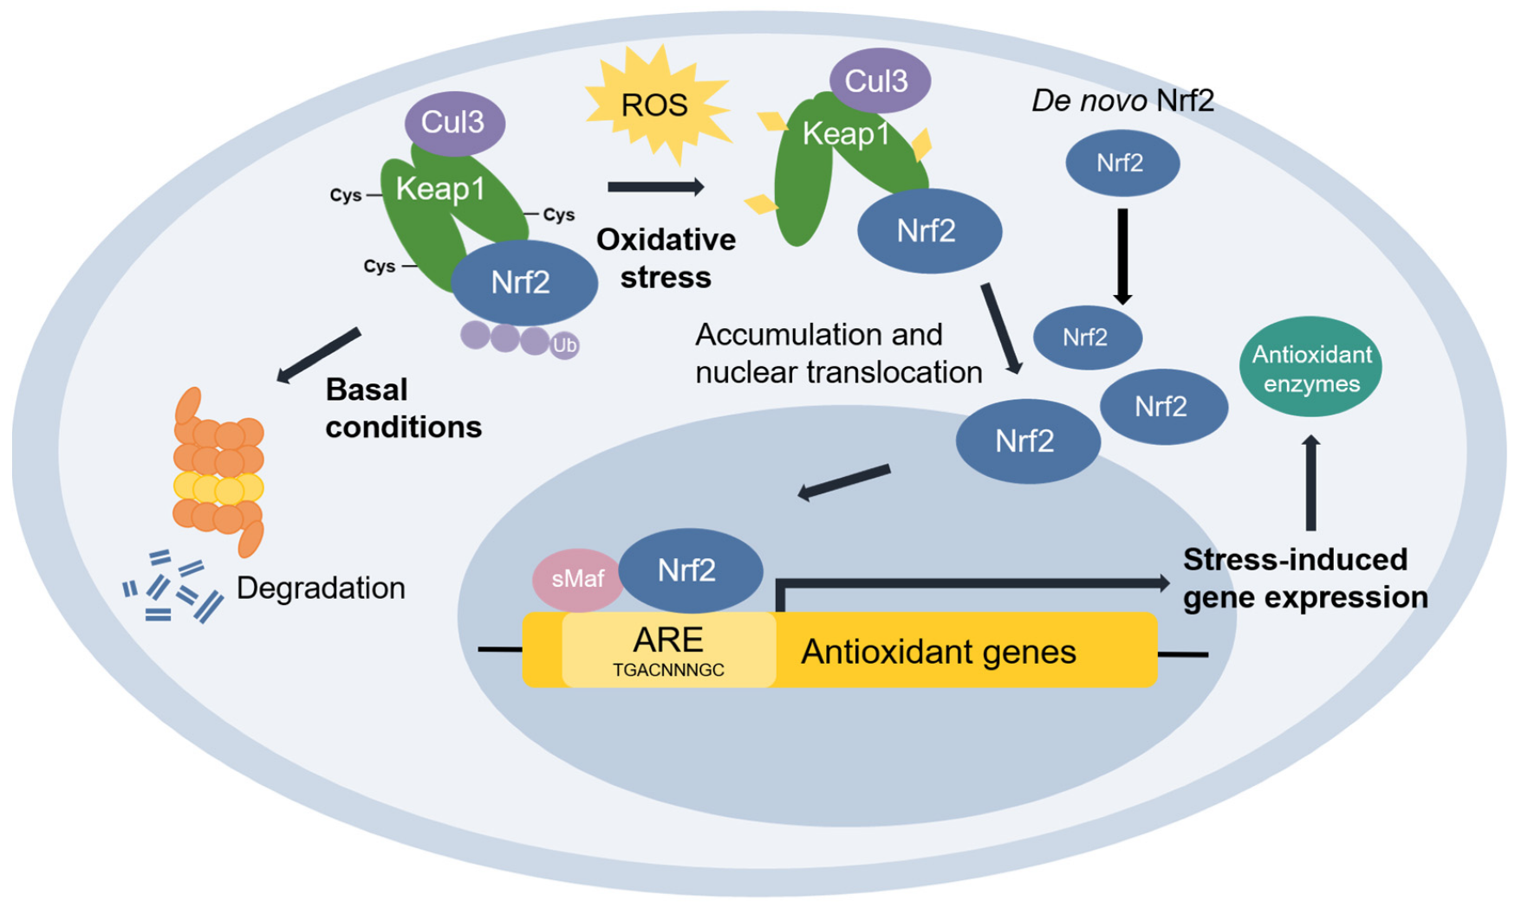
Hydroxytyrosol and Nrf2
We are going to take a closer look at Hydroxytyrosol (HT) and the Actions it takes regarding its Nrf2 activators and how this works in the body for the average person.
Hydroxytyrosol (HT) has demonstrated its ability to scavenge reactive oxygen species (ROS) and reactive nitrogen species by activating transcription factors such as the Nrf2. Upon oxidative stress, the transcription factor Nrf2 translocate to the nucleus and binds to the antioxidant responsive element (ARE) in the promoter region of genes. Encoding enzymes involved in the antioxidant response.
6

Slide 18
Nrf2 Clinical Perspective
Nrf2 can be targeted pharmacologically in diseases underlined by oxidative stress and inflammation, such as neurodegenerative, vascular, and metabolic diseases as well as cancer. Through its transcriptional targets, Nrf2 activation orchestrates a comprehensive and long-lasting protection that allows adaptation and survival under diverse forms of cellular stress. Pharmacological Nrf2 activators have shown protective effects in numerous models of human disease and benefits in human intervention trials, and NRF2 is considered a drug target.
Because of the connection between cellular oxidation, inflammation and the formation and development of a tumor, one can have a clear idea of the anticancer ability of this extract. Moreover, Hydroxytyrosol alters a tumor's biosynthesis and shows an inhibition of tumor cell proliferation.
On the other hand, Hydroxytyrosol (HT) is protective against neurodegenerative damage and cognitive decline associated with age or diseases like Alzheimer or Parkinson. This is because Hydroxytyrosol (HT) protects brain cells from lipid peroxidation because it can cross the blood–brain barrier.
6

Slide 19

Hydroxytyrosol and Nrf2
AKA, Olive leaf extract with Hydroxytyrosol (HT) releases Nrf2 activator which allows the body to “make its own antioxidants”? Or at least neutralizing free radicals which cause oxidative stress and damage cells. How do we know this? We used ORAC: Measurement of antioxidant: The oxygen radical absorbance capacity assay measures the radical chain breaking ability of antioxidants by monitoring the inhibition of peroxyl radical induced oxidation.
AKA for the AKA. Hydroxytyrosol (HT) reduces the pro-inflammatory cytokines.
6

Slide 20
Hydroxytyrosol:
Reduces Pro-Inflammatory Cytokines
.
For the past 2 years I have been trying to understand the
correlation or causation of the effectiveness of Olive Leaf
Extract against Covid19 and the Cytokine Storm.
The Nrf2 activator was the key. The Causation…
Hydroxytyrosol (HT) reduces the pro-inflammatory cytokines.
Case Study: In a family of 5, one person in the household tests positive for Covid19. How many others test positive. 60% is what’s expected.
Case Study: Vaccinated person gets Covid19 and has sever symptoms
lasting 6-9 days. Less than a year later same person tests positive for Covid19
and immediately starts taking Tree of Life XL and/or Feel Well.
6

Slide 21
Hydroxytyrosol Does Not Stop!
We know that we can neutralize free radicals and reduce/prevent damage they cause. What else could we do. Another area that Hydroxytyrosol (HT) seems to influence is
Vitamin C.
There is some debate on the BEST Vitamin C “ascorbic acid”, Whole vitamin C, Liposomal C, however I am not going to go into that specifically. Why did Vitamin C even hit my interest.
First, it was a part of a protocol to reduce Cytokine Storm. Vitamin C, Vitamin D, Magnesium, Melatonin, and Zink.
Second, most animals make their own Vitamin C. So, Vitamin C is not even a vitamin. A “Vitamin” is a molecule that is required for normal human function, but the body does not produce. Vitamin C is easily made from glucose in most animals. In the species that cannot make it, this is due to mutations in the GLO (L-gulono-y-lactone oxidase) gene which codes for the enzyme responsible for catalyzing the last step of Vitamin C biosynthesis from glucose.
6

Slide 22
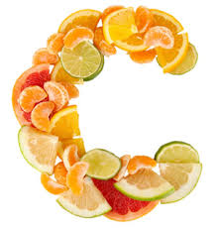
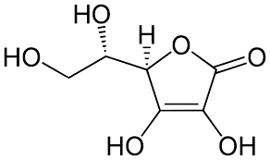
Hydroxytyrosol and Vitamin C
In humans, the gene coding for this enzyme is present, but it is silent. No, we do not know why. In a small, unpublished, study… volunteers took olive leaf extract which contained 50mg of Hydroxytyrosol (HT). Vitamin C blood levels increased between 50% and 200% after 1 week and 80% of the volunteers saw in increase after the first dose. Increases were observed up to 10 days into the two-week study. Dr. Levy believes that Hydroxytyrosol (HT) supplementation results in a stealth induction of the quiet enzyme in the liver and Vitamin C was produced by the volunteer's body. This would be a very large up hill battle to even discuss. What I am pointing out is the fact that your bodies have amazing abilities. Over the years I continue to find correlations to living healthy and olive leaf extract. I believe that one day I will be able to change these correlations to causations.
I’m not suggesting that there is a magic bullet in the world. However, the ability to decrease the quantity of supplements a person needs to take is huge.
What did we do about it all this fascinating knowledge?
6

Slide 23
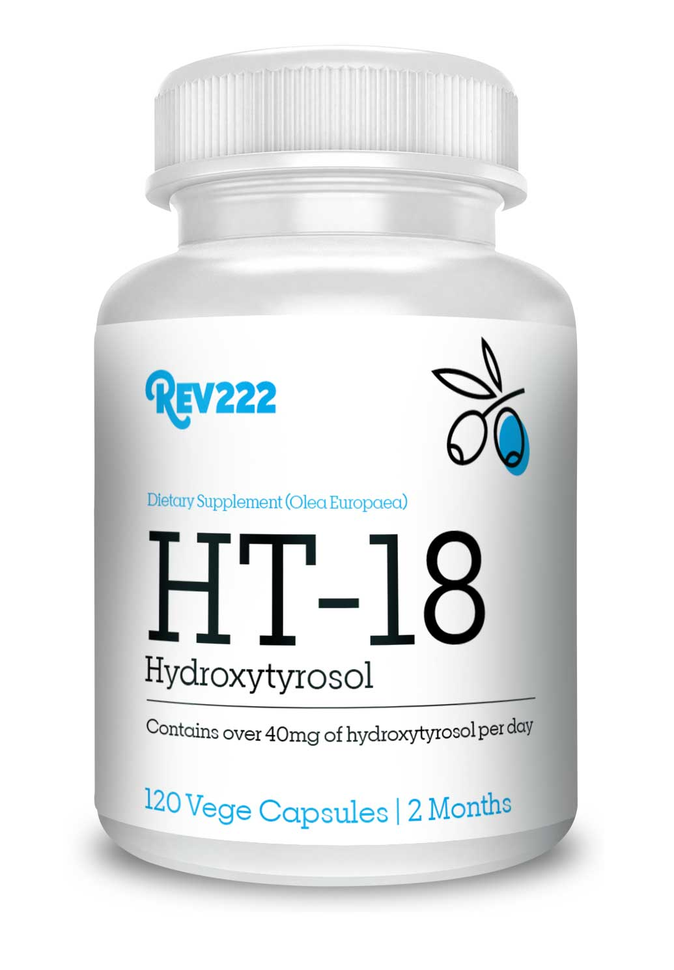
Hydroxytyrosol = HT-18
What is HT-18?
HT-18 is a powerful antioxidant that rapidly absorbs into your body supporting defense against free radicals. It contains a minimum of 18% Oleuropein and hydroxytyrosol along with 18 proprietary active ingredients that also offers immune boosting support.
Correlation vs Causation
What do we know!
WBC Potency Increases
Vitamin C Levels Increase
Reduction in Pro-Inflammatory Cytokines
We have great markers.
This time we focused heavily on Hydroxytyrosol (HT).
6

Slide 24
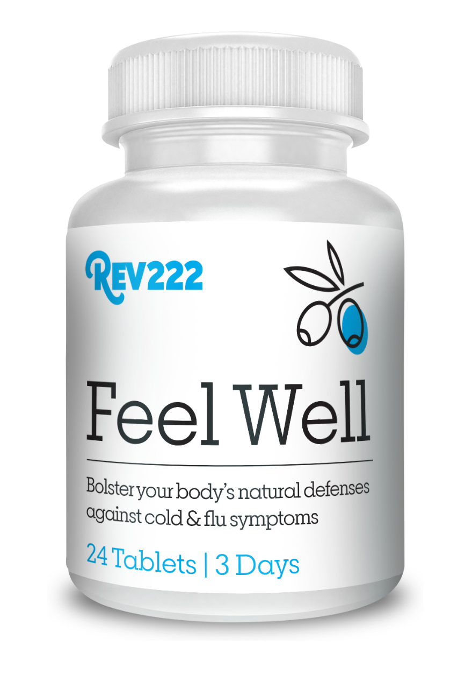
Hydroxytyrosol:
Dosing and Recommendations
Remember the Mediterranean diet. HT-18 is a daily maintenance product. We are working on your body daily overtime. For acute and chronic conditions, you will want to use Tree of Life XL and Feel Well.
Acute Issue: Feel Well
2 Tablets 4 times daily for three days. It is important not to stop taking the product even though symptoms subside in as little as two hours and in most cases within 10 hours.
Chronic Issue: Tree of Life XL
2 Tablets 3 times daily. Chronic issues did not happen overnight, and results will take time. Example: 80% overgrowth of candida will take 4-6 months for complete elimination. However, results will usually be seen within the first 30 days.
6
Notes:
At the end: Please note that the amount of HT drops dramatically as olive oil is refined. Also know that the oil has far less HT than the leaves. However the olives taste much better than the leaves.

Slide 25
Remember the Mediterranean Diet
Decreased Risk of Cardiovascular Diseases
Decreased Risk of Cancer
Decreased Risk of Neurodegeneration
Decreased Risk of Metabolic Diseases
Reduces the Pro-Inflammatory Cytokines
You have the resources available to educate yourself
and your patient’s!
Take the first step!
www.REV22-2.com
6

Slide 26
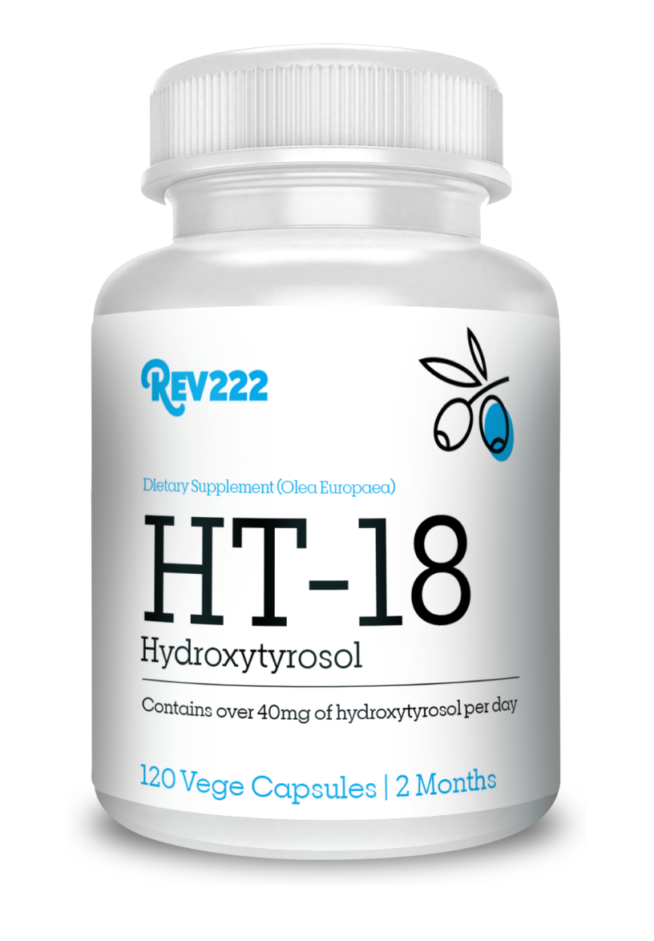
Hydroxytyrosol:
Little Known Secret
of the Olive Tree
by
Thank You!
www.REV22-2.com
6

