Slide 1

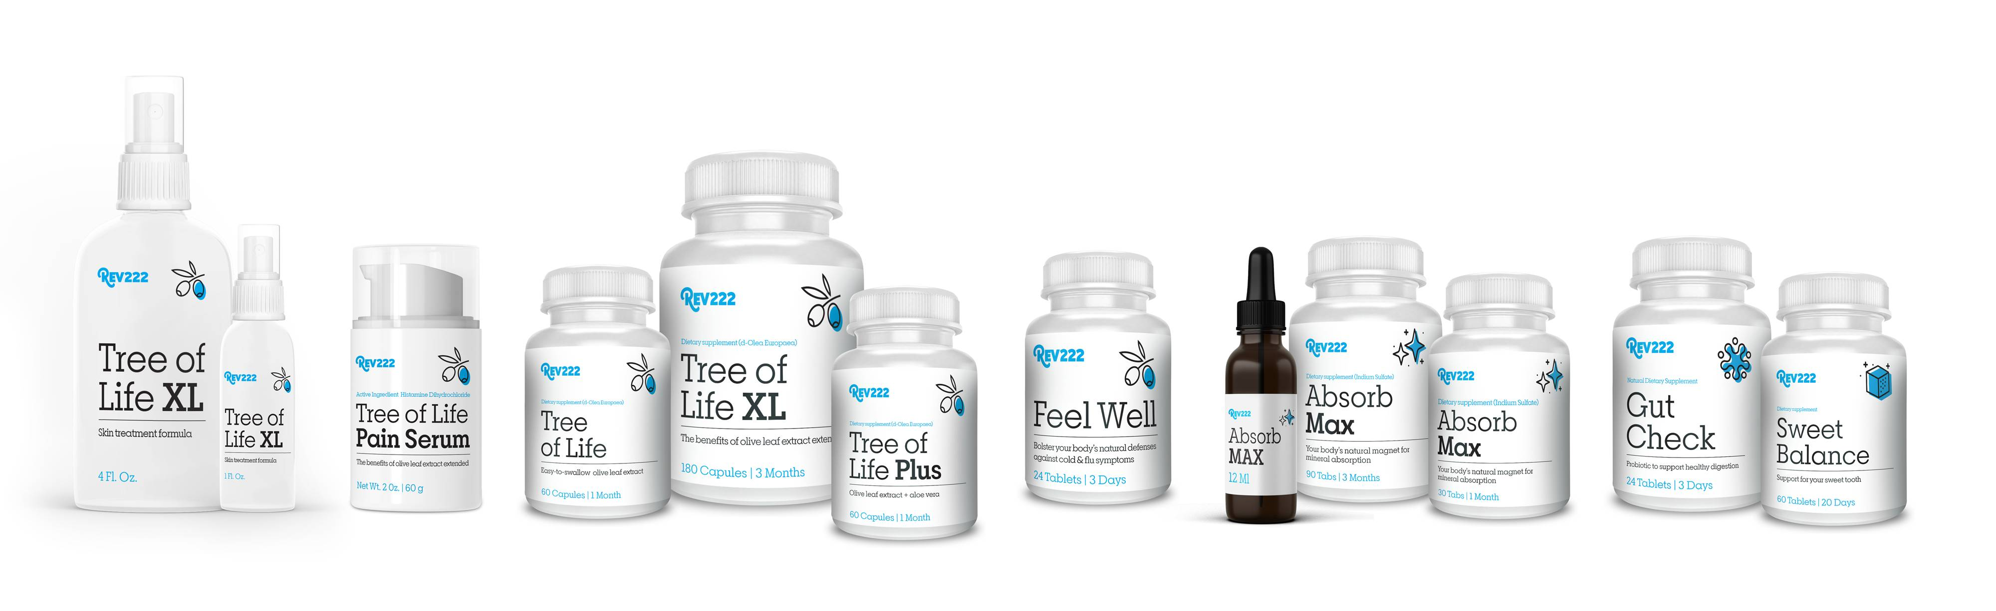
Hydroxytyrosol:
Little Known Secret of the Olive Tree
by
Notes:
Hello, I'd like to thank you for taking time today to listen about Hydroxytyrosol.
We are going to dive into Hydroxytyrosol, what it is, how to find it, what it does,
and provide you with the tools and resources, so that together, we can begin
changing lives. My name is Geoff Melcher and let's get started.

Slide 2

Who We Are & Why We’d Be Proud to Work With You
About Us:
Founded in 1995.
Manufactured in USA.
Creators of the patented Olive Leaf Extract product d-Lenolate.
Products are gluten free & non-GMO.
We are passionate supporters of the veteran's community on both a nation and international level.
Rev22-2 Philosophy's:
We are commitment to socially responsible, lawful and ethical business practices.
We believe creating healthy communities starts by supplying them with the best products on the market.
6
Notes:
Before we dive into Hydroxytyrosol, I want to take a minute and tell you a little bit
about who we are. We were founded in 1995, and still to this day all of our
products are manufactured in the United States. We have a patented extraction
process on our olive leaf extract known as d-lenolate. We will be talking more
about d-Lenolate and the research later today. All of our products are gluten free
and non-GMO and we are passionate supporters of the veteran community both
national and internationally. We are committed to socially responsible, lawful,
and ethical business practices. We believe creating healthy community starts
by supplying them with the best products on the market.

Slide 3
An olive leaf extract unlike any other!
Clinically-tested since 1995
No artificial colors
No animal byproducts
100% vegetable base capsules
No GMOs
No fillers
Patented & Extended Absorption Time
Tree of Life is Rev222’s olive leaf extract. It contains
d-Lenolate, our patented extraction process that extends the time your body has to absorb the active ingredients from 20 minutes to 8 hours. Our process preserves 18 more active ingredients within the olive leaf, and it offers daily immune boosting support by protecting against invading microorganisms and increasing white blood cell potency.
Our process has been tested and clinical studies have demonstrated that d-Lenolate® has anti-microbial, fungal, bacterial and vial activities.
6
Notes:
An Olive Leaf Extract Unlike Any Other!
Our olive leaf extract has been clinically tested since 1995,
it has no artificial colors, or animal byproducts.
It is not genetically modified and has no fillers. What does this mean…
we do not mix batches to standardize potency. We have a minimum
of 18% oleuropein that is expected with every batch.
What we get from the leaf is what we provide you.
A standard olive leaf extract has an absorption time of 20 minutes
where d-Lenolate lasts 8 hours. Our patented process also preserves
18 more active ingredients within the olive leaf and it offers
immune boosting support unlike any other supplement.
What I love about d-Lenolate, is that has been tested and clinically
studied and demonstrates anti-microbial fungal bacterial and
viral activities. And we have the studies to show it.

Slide 4
Studies & Research
The Effect of d-Lenolate® on the Immune Parameters of Humans
Preliminary Testing for Antiviral Properties of d-Lenolate® in Gel Formulation
In-vitro anti-HSV-1 Activities of d-Lenolate® at Different Concentrations
Preliminary Testing of Anti-Viral Properties of d-Lenolate®, Aloe and Neem Tissue Culture Experiments
Analysis of the LSU Safety Letter dated May 11th, 2009
Final Report from Animal Studies with d-Lenolate Formulation for an Effective Herpes Simplex Type 1 Treatment
Evaluation of East Park Research Formulations Containing d-Lenolate® as Antiviral for Effectiveness in Treating Topical Herpes Infections
In-vitro anti West Nile Virus Activities of d-Lenolate®
Antimicrobial Activities of d-Lenolate®
Therapeutic Effect of d-Lenolate® Against Experimental Infections and Immunocompromise Mice. (E coli, Pseudomonas aeruginosa and Candida albicans)
Enhanced Resistance Against Influenza Virus by Treatment with Dietary Supplement d-Lenolate® in Neutropenic Mice Induced by Cyclophophamide
In-vitro Antibacterial Effect of d-Lenolate® Against B. Anthracis
Evaluation of the Efficacy of d-Lenolate® in the Control of Symptoms of Candida Hypersensitivity Syndrome
Effects of d-Lenolate® in Modifying Symptoms of Arthritis
6
Notes:
I would like to highlight a few that I am most proud of…
Effect of d-Lenolate on the immune parameters of humans.
Yes on humans.. Anti HSV 1 Activities, Anti-Viral properties
Of d-Lenolate, Herpes Simplex 1 treatment, West Nile Virus
Resistance against influenza, not just any influenza H1N1 or Swine flu
And Candida Hypersensitivity Syndrom

Slide 5
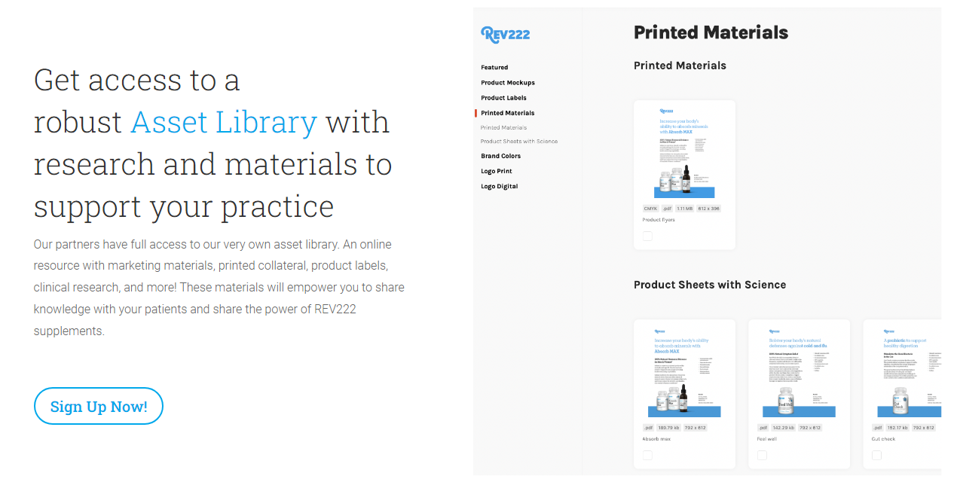
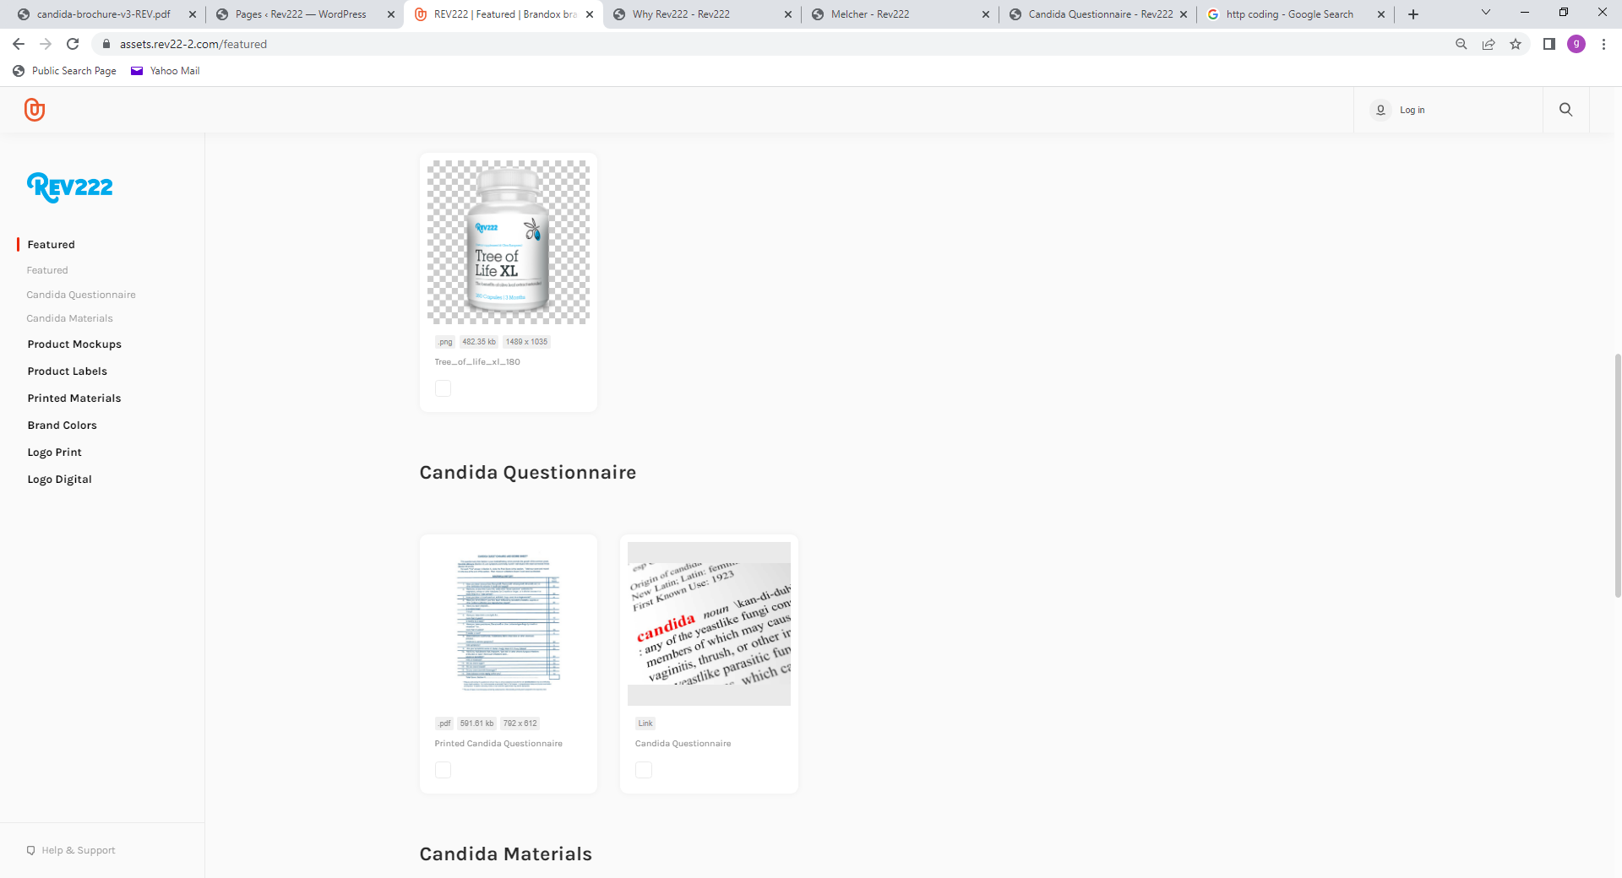
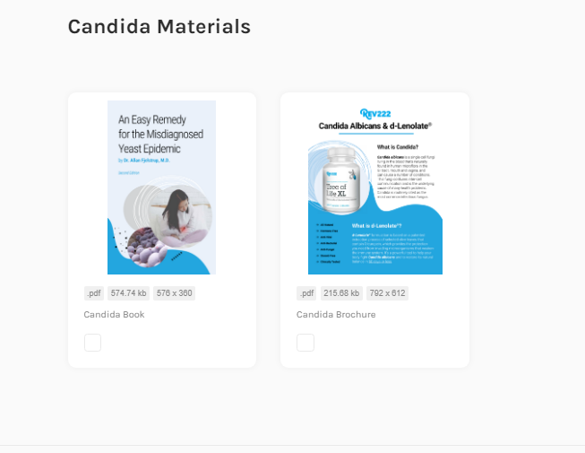
Assets available to you at any time!
Click and Download
We have 4 options for you once you create an account:
Print the questionnaire and have the patient complete on their own.
Login and go through the questionnaire with the patient.
Have your own private link that we host for you. The results get sent to you directly.
Add it to your own web page. We send you the API.
Assets.Rev22-2.com
6
Notes:
If you’re like me, you want a little more than just a title of a study.
We give you access to all the assets you might need.
This is where you can get product images. I know a lot of you
look closely at ingredients and we provide you with a copy
of all the product labels. Take a look at the right side. Printed Materials.
This is most commonly used feture, where you can access our product sheets and
the Science behind the products. With every product we offer we have science to back it.
This is just a great tool for you to get refreshed on any given product at any time.
These items are designed for you. Let’s take a look at some white sheets
We have also created assets that are designed for your patients.
This minimizes the amount of time that you have to spend on education.
Please spend as much time as you can, but this is just a tool that allows
you to maximize that time. Lets take a look at the assets for your
patients regarding Candida.

Slide 6
White Sheets
Assets.Rev22-2.com
6
Notes:
This product is sweet balance which is our natural supplement for maintaining blood sugar. This is a good example of what each of the white sheets are going to look like. On the left hand side you get general information about the product and some of the key points and then on the right side or the back of the piece of paper is where you'll see a synopsis of the research was done and some data behind that. For example you can see the dark line this is the pre blood sugar and then the lighter blue line is the post blood sugar after 60 days and the dramatic decrease we saw across every single person. One other thing I'd like to point out is our dosing which we do have in the blue box on the bottom right hand side or on the back of the piece of paper if you downloaded this and saw it at our assets.rev22-2.com.

Slide 7
White Sheets
Assets.Rev22-2.com
6
Notes:
This is our paint serum product great product again general information on the left and the difference with this one less about the research and study behind the olive leaf extract specifically and more on the specific ingredients we decided to add into the product such as emu oil MSM just the ingredients aloe Vera that we really wanted to highlight and and know that they were doing something for your body to help the healing process not just mask the pain that's associated with joints and muscles.

Slide 8
White Sheets
Assets.Rev22-2.com
6
Notes:
Get check one of my favorite products um you can see some of the research that we have associated this was done on cholesterol triglycerides uh what I love really about this product is that it is shelf stable does not need to be refrigerated and is designed to maintain a healthy gut it is not designed to rebuild a gut so this and all of our products are focused on working with your body not a replacement of what your body naturally does.

Slide 9
White Sheets
Assets.Rev22-2.com
6
Notes:
Absorb Max anyone over the age of 30 I challenge you to just simply try the product it is one of those that changes your outlook the mental clarity uh the hormonal regulation that takes place in both men and women for men low T women if they're going through pre or menopausal some of the benefits of that and we actually have a whole entire talk done specifically on this project that we've done in the years past fees feel free to link to that check it out really dives in it's the controversial secret and it's really frankly just a great product we did do testing on it fundamentally at its core we increase the absorption of trace minerals again working with your body and giving your body what it needs so that it can start and work and function properly.

Slide 10
White Sheets
Assets.Rev22-2.com
6
Notes:
Feel well again left hand side has some general information right hand side is the actual study research we did we tested the product specifically on H1N1 swine flu knocked it out of the park whether you take it prophylactically or at first sign the symptoms or even post first sign symptoms we do see great results depending on when it starts really depends on the length of time before we really start to see the desired effect this product specifically formulated to help with the symptoms associated and attacks the virus directly again one of those great products to just have available but really just trying to highlight that each one of our products does have some intention research and backing behind every single one of them.

Slide 11
White Sheets
Assets.Rev22-2.com
6
Notes:
Lastly our tree of life XL, our olive leaf extract unlike any other, that we've talked about. On the right is one of the research studies that I talking about. This study looked at the effect of d-Lenolate on humans. We literally drew blood and were able to see where we increased the white blood cell potency. The bottom right we do have the dosing to duplicate the results seen in the study. There's a lot that goes into different doses such as maintenance doses or if we're dealing with an acute or chronic condition. We do have other talks on that as well, but this was just one of those areas, I wanted to show you. All these tools, research and resources we do make available to you, anytime, if you forget something or you're at a show, simple and easy to reference back to the information. You don't need a code or a password; just go to assets dot rev22-2.com that's where you'll be able to not only see the printed material but these sheets just to help you give confidence. Also, there is no pricing, this is all about just sharing the information and the research that we've done over the many years.

Slide 12
The Effect of d-Lenolate on the Immune
Parameters of Healthy Volunteers
T cells are a major component of an adaptive immune system.
Roles include directly killing infected host cells, activating other immune cells, producing cytokines and regulating the immune response.
Activated T cell: activation antigen carrying T cells within the T cells.
Activated Th cell: activation antigen molecule carrying helper T cells within the helper T cells.
Activated Tc cell: activation antigen expressing cytotoxic T lymphocytes within the cytotoxic T lymphocytes.
CD71 positive T: transferring receptor molecule carrying T cells within the T cells.
CD71 positive B: transferring receptor molecule carrying B cells within the B cells.
6
Notes:
Because this is my favorite study here is the data up-close. Those blue show increase in the T cells TH cells some of the different activators we saw an increase all the way through you'll see a little tiny black line that's because we actually saw a decrease in some very few people and one of the very interesting properties of all of leaf extract is is is immune modulator so there are times where we see it so if we do have a hyperactive immune system we do know we can calm that down this is helpful for different issues such as psoriasis if you will and then you'll see the white there is where there's there was no change whatsoever but even being able to see a change in the immune system on a cellular level is truly unlike any other product out there
Across the board the results were phenomenal, specifically
the T cells and the helper T cells, they performed remarkably.
Now you'll also notice there were a few decreases in these
categories and also the TC cells. What is interesting about
olive leaf extract is that it is an immunomodulator.
That's what we're seeing here. it's people that have an
overactive immune system, d-lenolate will begin to calm the
immune system and we're seeing this in a small percentage
of subjects… largely across the board we were able to see
this boosting of your immune system on this cellular level.

Slide 13
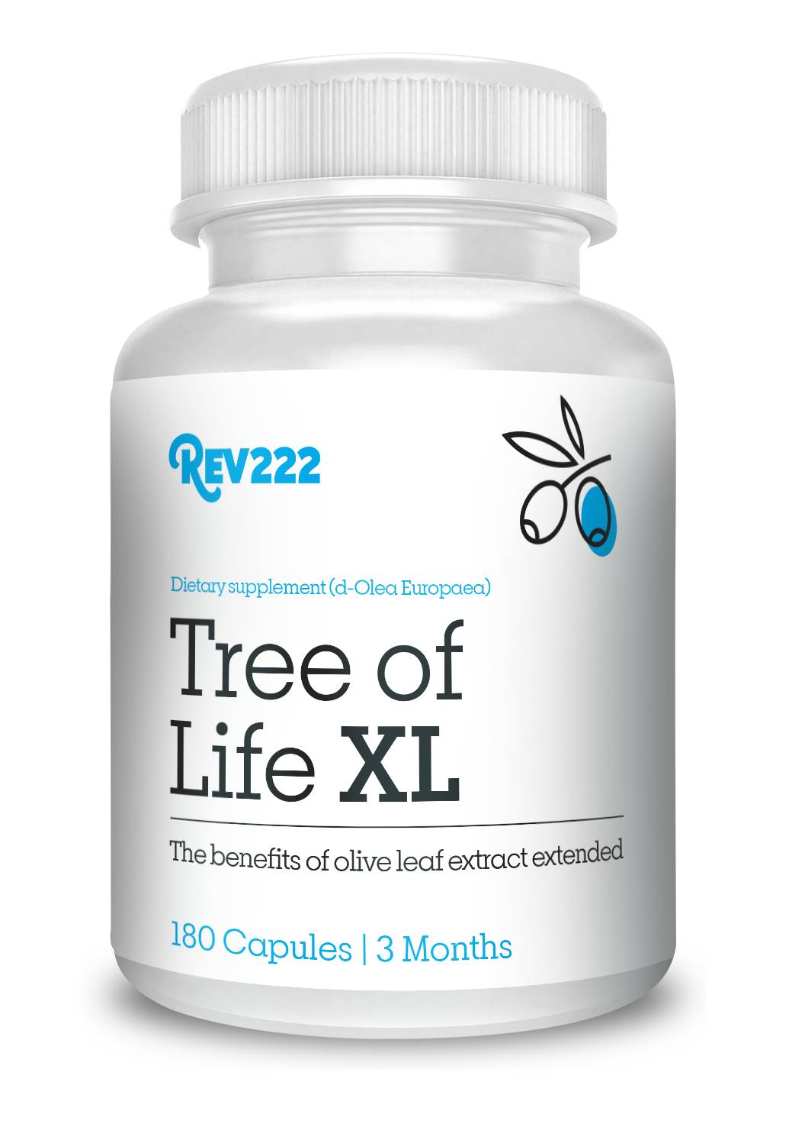
An olive leaf extract unlike any other!
Preserving 18 MORE active ingredients.
We control every step of the manufacturing process.
We test the leaves from the tree.
We test the liquid in the extraction process.
We test the powder from the drying process.
We test the capsules from the bottling process.
We are in control of every step of the process and look for specific markers. Hence, 18 MORE active ingredients.
Olive leaves are widely used in natural medicine with beneficial effect on health care due to their bioactive properties. Olive leaf extract contains large amounts of polyphenolic compounds that include oleuropein and flavonoids with antioxidant,
anti-inflammatory and antimicrobial properties.
How did we get here? Let's look at the Mediterranean diet.
Clinically-tested since 1995
No artificial colors
No animal byproducts
100% vegetable base capsules
No GMOs
No fillers
6
Notes:
How do we do this? Preserving 18 more active ingredients is the key but we get there because we test the leaves directly from the tree, then we test the liquid during the extraction process, we also test the powder once the drying process is completed and finally, we test it again after the capsules are made in the bottling process. We are in control of every step along the process and are looking for very specific markers along the way. Olive leaves are widely used in medicine with beneficial effects. Olive leaf extract contains large amounts of polyphenolic compounds that include oleuropein flavonoids and has anti-inflammatory and antimicrobial properties. When looking at these proprietary properties we notice something very interesting about the properties and the Mediterranean diet.

Slide 14

18 MORE Active Ingredients:
Hydroxytyrosol
The Mediterranean diet has been associated with a minor risk of cardiovascular diseases and cancer. Particularly, olive oil plays a key role in these benefits, due to its composition of fat, richness in monounsaturated fatty acids (oleic acid) and other micronutrients.
6
Notes:
Mediterranean diet has been associated with the minor risk of cardiovascular disease and cancer particularly olive oil and olives play a key role in these benefits this is due to the composition of fat, fatty acids and other micronutrients.

Slide 15
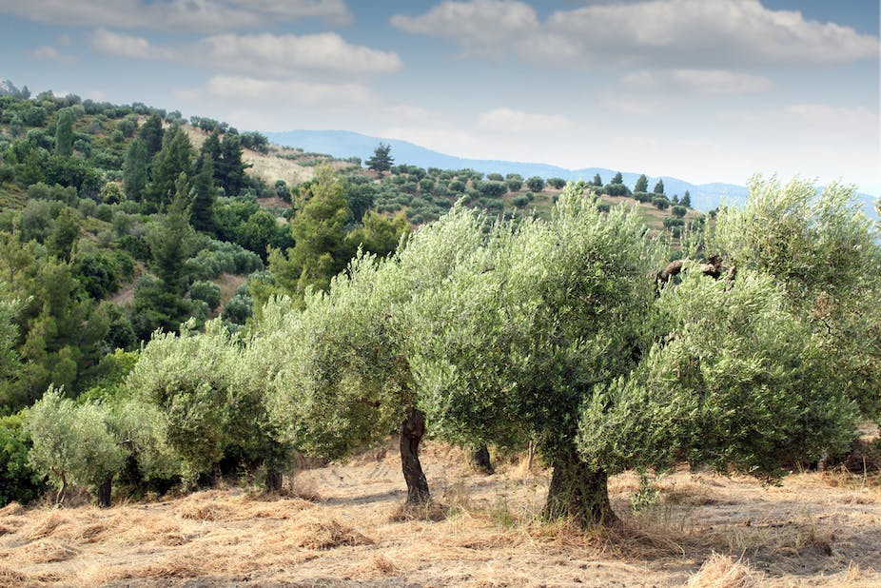
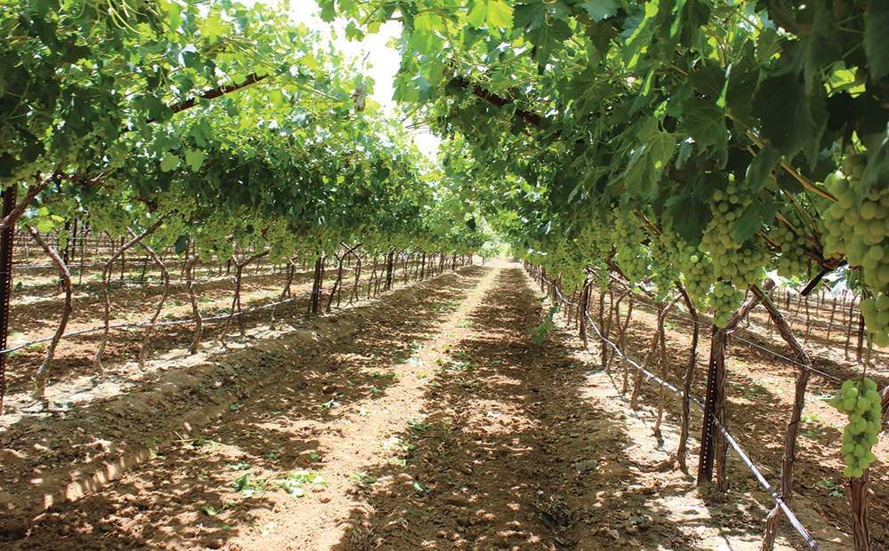
18 MORE Active Ingredients:
Hydroxytyrosol
A very common active ingredient that most of you have probably heard of is oleuropein. A less common ingredient that over the past year has gotten more and more notoriety is Hydroxytyrosol.
Hydroxytyrosol is one of those micronutrients. It is a potent antioxidant from extra virgin olive oil and olives. We know that there is great variability in the nutrients given to the olives and the leaves. This molecule may be the secret of the Mediterranean diet. The typical Spaniard nets about 5.6mg daily of Hydroxytyrosol.
The variability is due to altitude, latitude, variety of olive tree, the harvesting and processing conditions.
6
Notes:
A common active ingredient that most of you probably have heard of is all European a less common ingredient that few years has gotten more and more notoriety is hydroxytyrosol. Hydroxytyrosol is one of those micronutrients. It is a potent antioxidant from EVOO and olives. We know that there is great variability in the nutrients given to the olives and the leaves. This molecule may be the secret to the Mediterranean diet and the typical Spaniard nets about 5.6 milligrams of hydroxytyrosol each day. Please note that the amount of HT drops dramatically as olive oil is refined. Also know that the oil has far less HT than the leaves. However, the olives taste much better than the leaves. The variability is due to altitude latitude variety of all of trees harvesting processing conditions. The best way to explain this is looking at Wine.

Slide 16
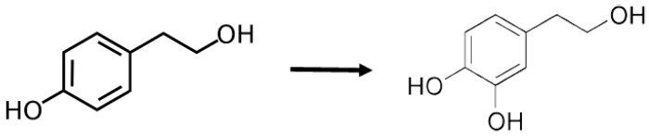
Hydroxytyrosol:
Most Potent Natural Antioxidant Know
Hydroxytyrosol (HT) is one of the most potent natural antioxidants known – 10 times more potent than green tea and twice as potent as CoQ10. It is also found in the olive tree leaf. The tree leaves make it as part of its defense against the elements and stress.
Hydroxytyrosol (HT) is quite a uniqu molecule. Unlike curcumin, which has low absorption, HT has well over 90% absorption rate and in fact is closer to 99%. It is both water and oil soluble, making it very versatile in getting acress membranes, into your system and into the “ACTION”
HT belongs to the phenolic group of compounds, which included bioflavonoids. Tyrosol is powerful in its own right, but the additional OH, or hydroxy, group makes it far more active.
Tyrosol Hydroxytyrosol
Phenolic compound from olive leaves and oil
6
Notes:
Hydroxytyrosol is one of the most potent natural antioxidants known. It is 10 times more potent than green tea and twice as potent as coq 10. The great news is that hydroxytyrosol is also found in the olive leaf. The leaves make it as part of the defense against the elements and stress. Hydroxytyrosol is a unique molecule unlike curcumin, which has a low absorption, hydroxytyrosol has well over 90% absorption rate and is closer to 99% it's both water and oil soluble making it very versatile. Allowing it into your system and into the action. Hydroxytyrosol belongs to the phenolic group of compounds which include bioflavonoids. Tyrosol is powerful in its own right but the addition of a hydroxy group makes it far more active.

Slide 17
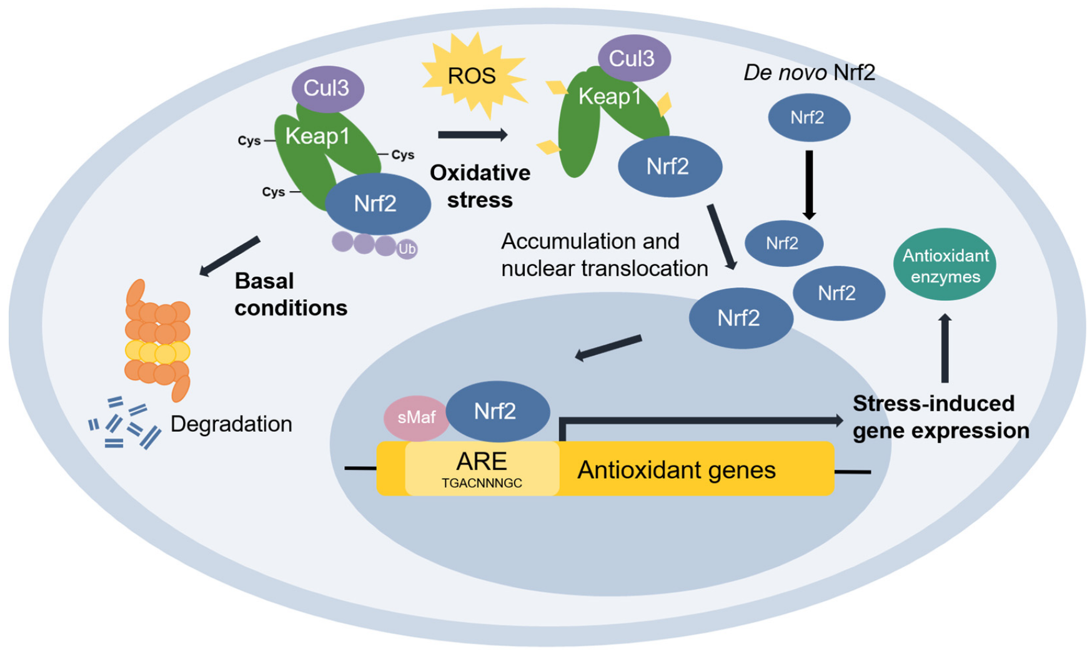
What does an antioxidant do?
We are going to take a closer look at Hydroxytyrosol (HT) and the Actions it takes regarding its Nrf2 activators and how this works in the body for the average person.
Hydroxytyrosol (HT) has demonstrated its ability to scavenge reactive oxygen species (ROS) and reactive nitrogen species by activating transcription factors such as the Nrf2. Upon oxidative stress, the transcription factor Nrf2 translocate to the nucleus and binds to the antioxidant responsive element (ARE) in the promoter region of genes. Encoding enzymes involved in the antioxidant response.
6
Notes:
At the end: Please note that the amount of HT drops dramatically as olive oil is refined. Also know that the oil has far less HT than the leaves. However the olives taste much better than the leaves.

Slide 18
Nrf2 Clinical Perspective
Nrf2 can be targeted pharmacologically in diseases underlined by oxidative stress and inflammation, such as neurodegenerative, vascular, and metabolic diseases as well as cancer. Through its transcriptional targets, Nrf2 activation orchestrates a comprehensive and long-lasting protection that allows adaptation and survival under diverse forms of cellular stress. Pharmacological Nrf2 activators have shown protective effects in numerous models of human disease and benefits in human intervention trials, and NRF2 is considered a drug target.
Because of the connection between cellular oxidation, inflammation and the formation and development of a tumor, one can have a clear idea of the anticancer ability of this extract. Moreover, Hydroxytyrosol alters a tumor's biosynthesis and shows an inhibition of tumor cell proliferation.
On the other hand, Hydroxytyrosol (HT) is protective against neurodegenerative damage and cognitive decline associated with age or diseases like Alzheimer or Parkinson. This is due to the fact that Hydroxytyrosol (HT) protects brain cells from lipid peroxidation because it can cross the blood–brain barrier
6
Notes:
At the end: Please note that the amount of HT drops dramatically as olive oil is refined. Also know that the oil has far less HT than the leaves. However the olives taste much better than the leaves.

Slide 19

What does an antioxidant do?
AKA, Olive leaf extract with Hydroxytyrosol (HT) releases Nrf2 activator which allows the body to “make its own antioxidants”? Or at least neutralizing free radicals which cause oxidative stress and damage cells. How do we know this? We used ORAC: Measurement of antioxidant: The oxygen radical absorbance capacity assay measures the radical chain breaking ability of antioxidants by monitoring the inhibition of peroxyl radical induced oxidation.
AKA for the AKA. Hydroxytyrosol (HT) reduces the pro-inflammatory cytokines.
6
Notes:
At the end: Please note that the amount of HT drops dramatically as olive oil is refined. Also know that the oil has far less HT than the leaves. However the olives taste much better than the leaves.

Slide 20
Hydroxytyrosol:
Reduces Pro-Inflammatory Cytokines
.
For the past 2 years I have been trying to understand the
correlation or causation of the effectiveness of Olive Leaf
Extract against Covid19 and the Cytokine Storm.
The Nrf2 activator was the key. The Causation…
Hydroxytyrosol (HT) reduces the pro-inflammatory cytokines.
Case Study: In a family of 5, one person in the household tests positive for Covid19. How many others test positive. 60% is what’s expected.
Case Study: Vaccinated person gets Covid19 and has sever symptoms
lasting 6-9 days. Less than a year later same person tests positive for Covid19
and immediately starts taking Tree of Life XL and/or Feel Well.
6
Notes:
At the end: Please note that the amount of HT drops dramatically as olive oil is refined. Also know that the oil has far less HT than the leaves. However the olives taste much better than the leaves.

Slide 21
Hydroxytyrosol Does Not Stop!
We know that we can neutralize free radicals and reduce/prevent damage they cause. What else could we do. Another area that Hydroxytyrosol (HT) seems to influence is
Vitamin C.
There is some debate on the BEST Vitamin C “ascorbic acid”, Whole vitamin C, Liposomal C, however I am not going to go into that specifically. Why did Vitamin C even hit my interest.
First, it was a part of a protocol to reduce Cytokine Storm. Vitamin C, Vitamin D, Magnesium, Melatonin, and Zink.
Second, most animals make their own Vitamin C. So, Vitamin C is not even a vitamin. A “Vitamin” is a molecule that is required for normal human function, but the body does not produce. Vitamin C is easily made from glucose in most animals. In the species that cannot make it, this is due to mutations in the GLO (L-gulono-y-lactone oxidase) gene which codes for the enzyme responsible for catalyzing the last step of Vitamin C biosynthesis from glucose.
6
Notes:
90% of infections are caused by 5 species with the most common
being Candida Albicans. How do we find Candidiasis?
Modern laboratory methods for detecting candida have not kept
pace with this epidemic. One researcher believes elevated immune
complexes are likely indicators, specifically immunoglobin A and
immunoglobin G… Downside of these labs, it does not look at IgA or G.
Blood Cell analysis and/or yeast cultures can be done more readily.
However, most of the time Candida is identified by the patient's diet and
if there are any external indicators like fingernails.
Doctors are hesitant to diagnose systemic Candidiasis due to minimal
testing procedures available. Cultures are the simplest form of diagnosis,
Yet, are not sensitive enough to reliably rule out infection when they are negative.
Yes, a negative result does not rule out candida. However, there are no other tests
Better than blood cultures. Therefor blood cultures are the most common method
for establishing Candidiasis. Sounds great right! The sensitivity is 70 to 80% and
may take several days to become positive.
In reality: Doctors become aware of systemic Candidiasis from positive blood cultures
and/or when patients are not responding to anti-bacterial drugs.
Empirical therapy is adopted, aka treat 10 different things and lets hope we stop it!
This is considered appropriate and a recommended form of treatment.

Slide 22
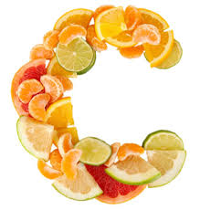
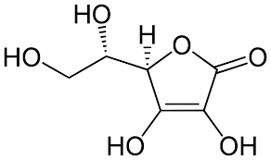
The Candida Disguise Dilemma
In humans, the gene coding for this enzyme is present, but it is silent. No, we do not know why. In a small, unpublished, study… volunteers took olive leaf extract which contained 50mg of Hydroxytyrosol (HT). Vitamin C blood levels increased between 50% and 200% after 1 week and 80% of the volunteers saw in increase after the first dose. Increases were observed up to 10 days into the two-week study. Dr. Levy believes that Hydroxytyrosol (HT) supplementation results in a stealth induction of the quiet enzyme in the liver and Vitamin C was produced by the volunteer's body. This would be a very large up hill battle to even discuss. What I am pointing out is the fact that your bodies have amazing abilities. Over the years I continue to find correlations to living healthy and olive leaf extract. I believe that one day I will be able to change these correlations to causations.
Im not suggesting that there is a magic bullet in the world. However, the ability to decrease the quantity of supplements a person needs to take is huge.
What did we do about it all this fascinating knowledge?
6
Notes:
90% of infections are caused by 5 species with the most common
being Candida Albicans. How do we find Candidiasis?
Modern laboratory methods for detecting candida have not kept
pace with this epidemic. One researcher believes elevated immune
complexes are likely indicators, specifically immunoglobin A and
immunoglobin G… Downside of these labs, it does not look at IgA or G.
Blood Cell analysis and/or yeast cultures can be done more readily.
However, most of the time Candida is identified by the patient's diet and
if there are any external indicators like fingernails.
Doctors are hesitant to diagnose systemic Candidiasis due to minimal
testing procedures available. Cultures are the simplest form of diagnosis,
Yet, are not sensitive enough to reliably rule out infection when they are negative.
Yes, a negative result does not rule out candida. However, there are no other tests
Better than blood cultures. Therefor blood cultures are the most common method
for establishing Candidiasis. Sounds great right! The sensitivity is 70 to 80% and
may take several days to become positive.
In reality: Doctors become aware of systemic Candidiasis from positive blood cultures
and/or when patients are not responding to anti-bacterial drugs.
Empirical therapy is adopted, aka treat 10 different things and lets hope we stop it!
This is considered appropriate and a recommended form of treatment.

Slide 23
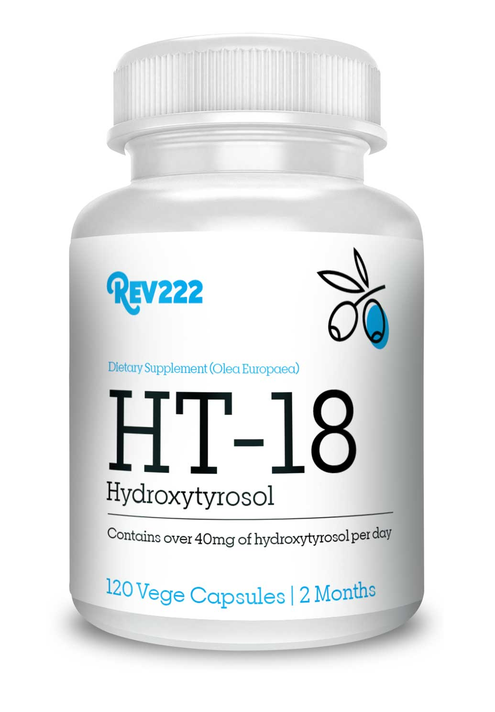
The Origin of Hydroxytyrosol
What is HT-18?
HT-18 is a powerful antioxidant that rapidly absorbs into your body supporting defense against free radicals. It contains a minimum of 18% Oleuropein and hydroxytyrosol along with 18 proprietary active ingredients that also offers immune boosting support.
Correlation vs Causation
What do we know!
WBC Potency Increases
Vitamin C Levels Increase
Reduction in Pro-Inflammatory Cytokines
We have great markers.
This time we focused heavily on Hydroxytyrosol (HT).
6
Notes:
At the end: Please note that the amount of HT drops dramatically as olive oil is refined. Also know that the oil has far less HT than the leaves. However the olives taste much better than the leaves.

Slide 24
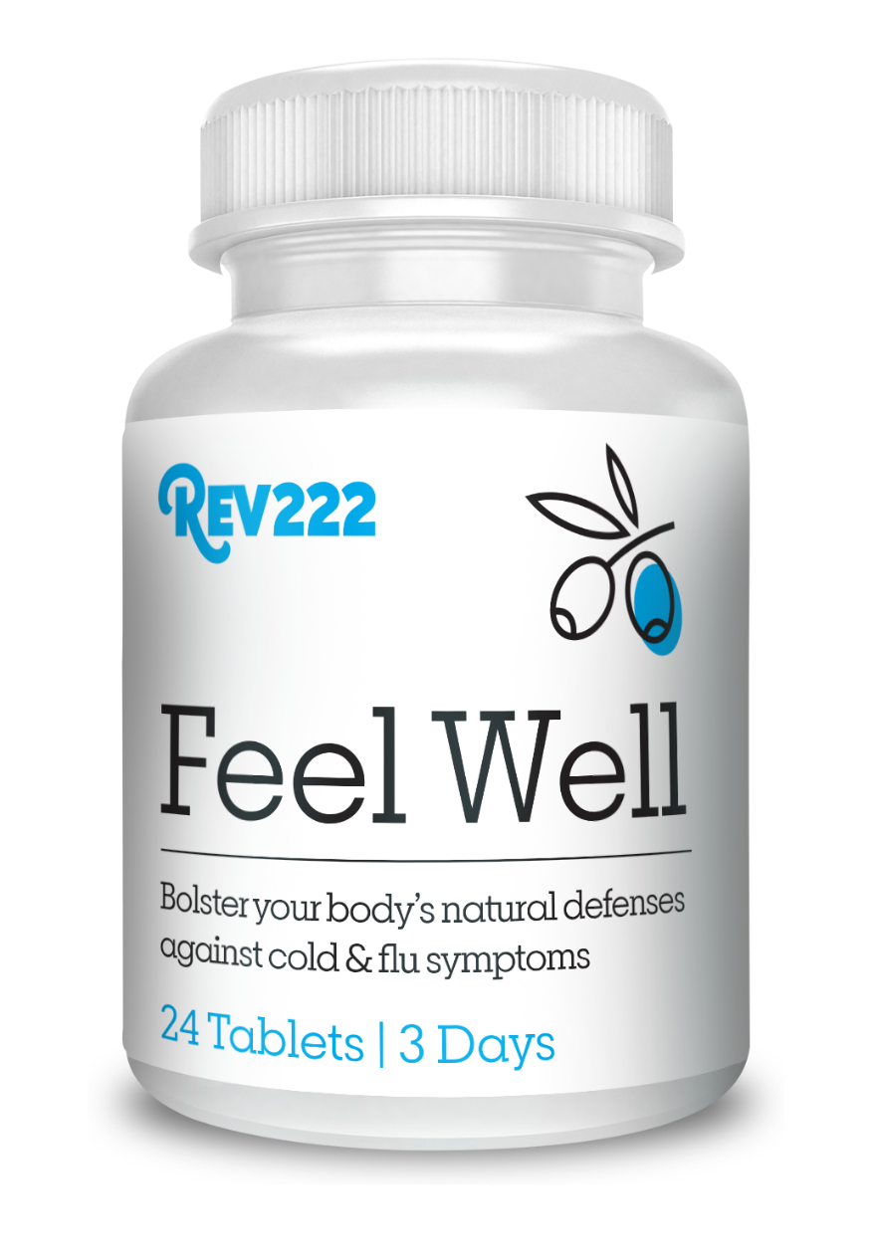
Hydroxytyrosol:
Dosing and Recommendations
Remember the Mediterranean diet. HT-18 is a daily maintenance product. We are working on your body daily overtime. For acute and chronic conditions, you will want to use Tree of Life XL and Feel Well.
Acute Issue: Feel Well
2 Tablets 4 times daily for three days. It is important not to stop taking the product even though symptoms subside in as little as two hours and in most cases within 10 hours.
Chronic Issue: Tree of Life XL
2 Tablets 3 times daily. Chronic issues did not happen overnight, and results will take time. Example: 80% overgrowth of candida will take 4-6 months for complete elimination. However, results will usually be seen within the first 30 days.
6
Notes:
At the end: Please note that the amount of HT drops dramatically as olive oil is refined. Also know that the oil has far less HT than the leaves. However the olives taste much better than the leaves.

Slide 25
Remember the Mediterranean Diet
Decreased Risk of Cardiovascular Diseases
Decreased Risk of Cancer
Decreased Risk of Neurodegeneration
Decreased Risk of Metabolic Diseases
Reduces the Pro-Inflammatory Cytokines
You have the resources available to educate yourself
and your patient’s!
Take the first step!
www.REV22-2.com
6
Notes:
Candida, The Misdiagnosed yeast epidemic.
We learned Candida is an opportunistic infector.
Candida effects most people whether they know it or not.
It can hide from us very well. And d-Lenolate
Is an effective tool. You not only have the resources available
To educate yourself at any time you have the resources to
Educate you patients. Now it is up to you to take the first
Step and create an account and start changing lives.

Slide 26
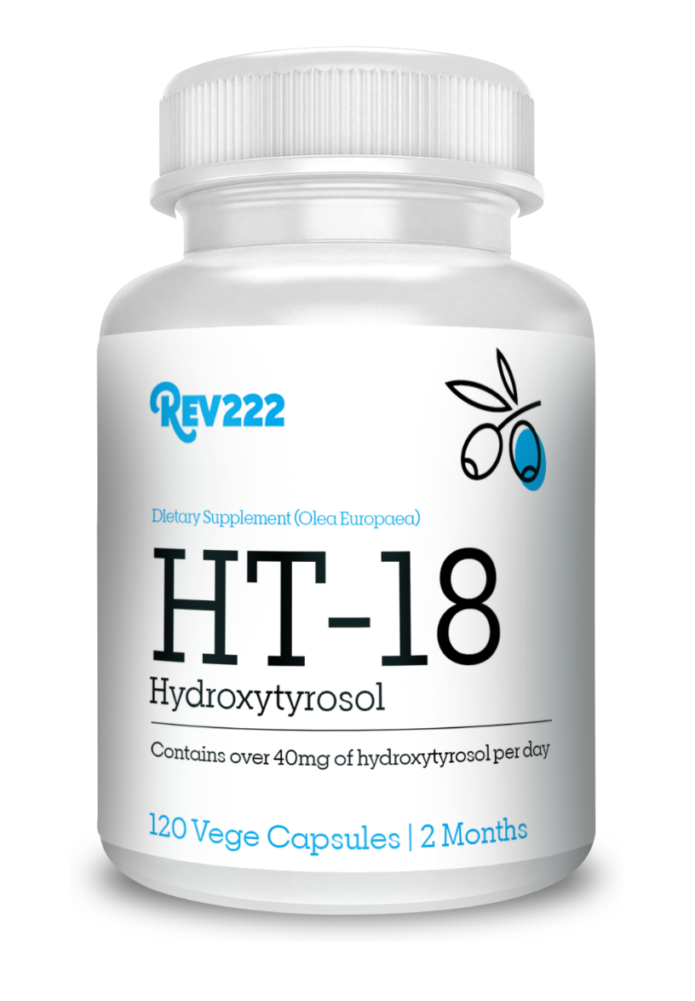
Hydroxytyrosol:
Little Known Secret
of the Olive Tree
by
Thank You!
www.REV22-2.com
6
Notes:
Thank you very much for taking the time today to
Educate yourself on Candida. Have a wonderful day!

